Slide 1
Artistic Stylization of Images and Video Part III – Anisotropy and Filtering Eurographics 2011
Jan Eric Kyprianidis
Hasso-Plattner-Institut, University of Potsdam, Germany

Slide 2
Image/Video Abstraction
Stylized Augmented Reality for Improved Immersion
Fischer et al., 2005
Real-time Video Abstraction
Winnemöller et al., SIGGRAPH 2006
Coherent Line Drawings
Kang et al., NPAR 2007
Structure Adaptive Image Abstraction
Kyprianidis & Döllner, EG Theory and Practice of Computer Graphics 2008
Flow-based Image Abstraction
Kang et al., Transactions on Visualization and Computer Graphics 2009
Artistic Edge and Corner Preserving Smoothing
Papari et al., IEEE Transactions on Image Processing 2007
Image and Video Abstraction by Anisotropic Kuwahara Filtering
Kyprianidis et al., Pacific Graphics 2009
Shape-simplifying Image Abstraction
Kang & Lee, Pacific Graphics 2008
Image and Video Abstraction by Coherence-Enhancing Filtering
Kyprianidis & Kang, Eurographics 2011

Slide 3
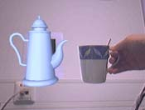
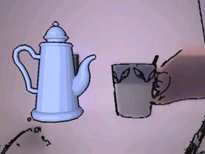
Stylized Augmented Reality for Improved Immersion Fischer et al. (2005)
Non-photorealistic display of both the camera image and virtual objects:
Abstraction: Bilateral filter applied to Gaussian pyramid and then upsampled
Edges: Canny edge detector + morphological dilation
Conventional augmented reality
Stylized
augmented reality
Image credit: Fischer et. al. (2005)

Slide 4
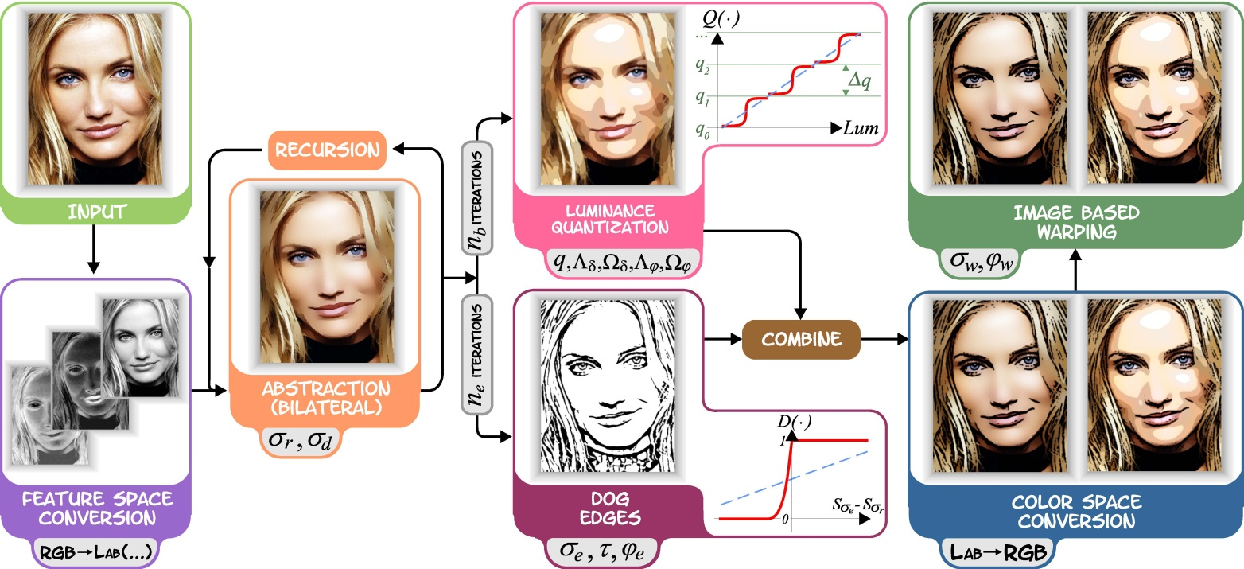
Real-time Video Abstraction Winnemöller et al. (2006)
Abstraction: Multiple iterations of xy-separable bilateral filter + color quantization
Edges: Difference of Gaussians + thresholding
Image credit: Winnemöller et. al. (2006)

Slide 5
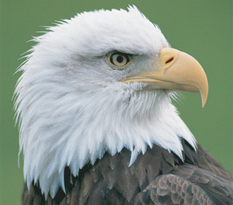
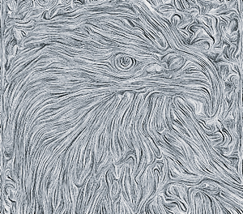
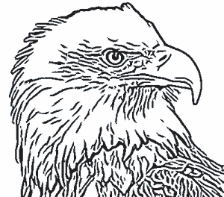
Coherent Line Drawings Kang et al. (2007)
Edges: 1D difference of Gaussians directed by flow field + flow-guided smoothing and thresholding.
Image credit: Kang et. al. (2007)
Input image
Edge Tangent Flow
Line drawing
Flow-based filtering

Slide 6
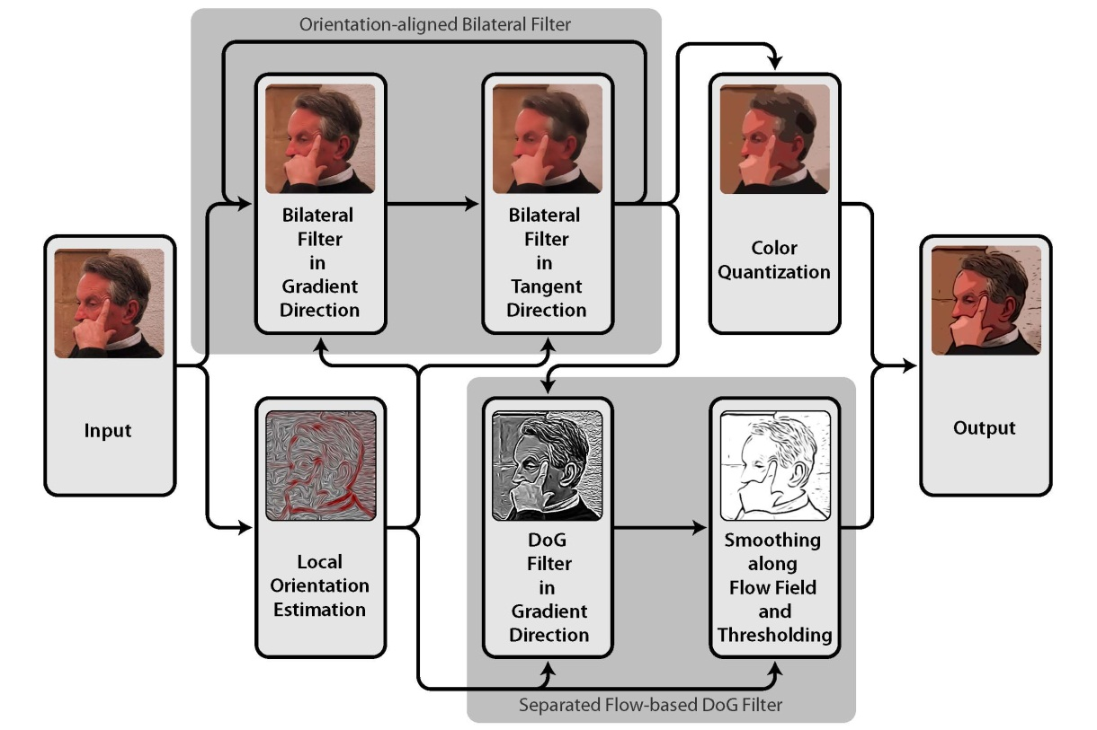
Structure Adaptive Image Abstraction Kyprianidis & Döllner (2008)
Abstraction: Multiple iterations of orientation-aligned bilateral filter
Edges: separable flow-based difference of Gaussians
Original photograph
copyright
Anthony Santella
Local orientation and an anisotropy measure derived from the smoothed structure tensor are used to guide the bilateral and difference of Gaussians filters

Slide 7
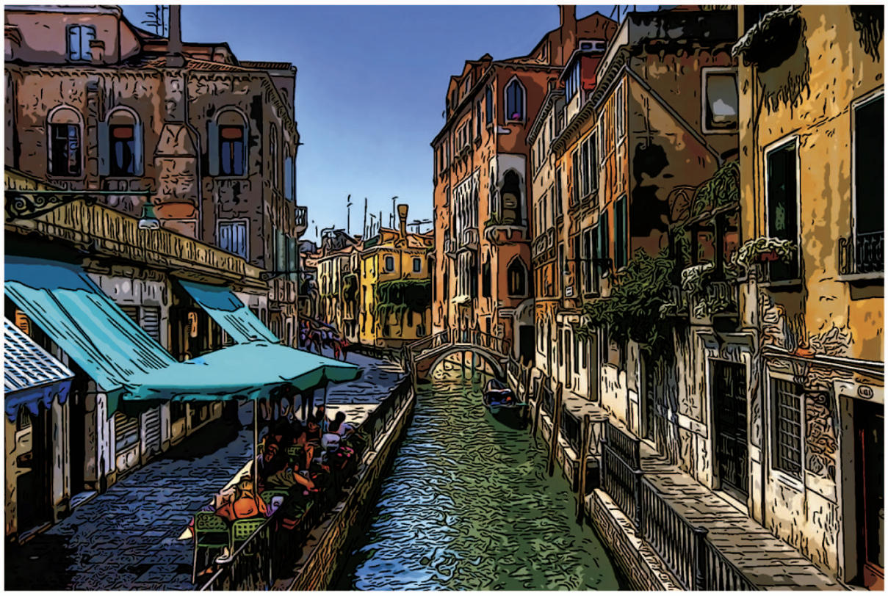
Flow-based Image Abstraction Kang et al. (2009)
Abstraction: Multiple iterations of flow-based bilateral filter
Edges: (separable) flow-based difference of Gaussians
Local orientation estimation of both techniques is based on the edge tangent flow (ETF)
Image credit: Kang et. al. (2009)

Slide 8
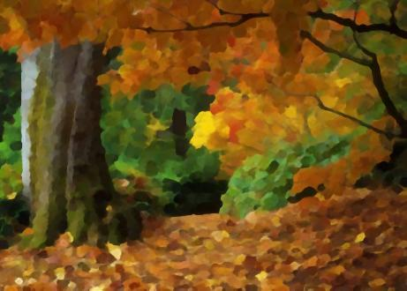
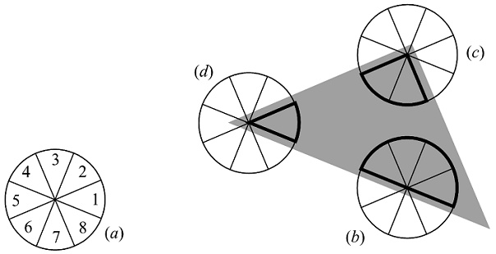
Artistic Edge and Corner Preserving Smoothing Papari et al. (2009)
Generalization of the Kuwahara filter. Creates output with a painterly look.
Addresses two key issues of the original Kuwahara filter:
Rectangular subregions
Unstable subregion selection process
Credit for images: Papari et. al. (2009)

Slide 9
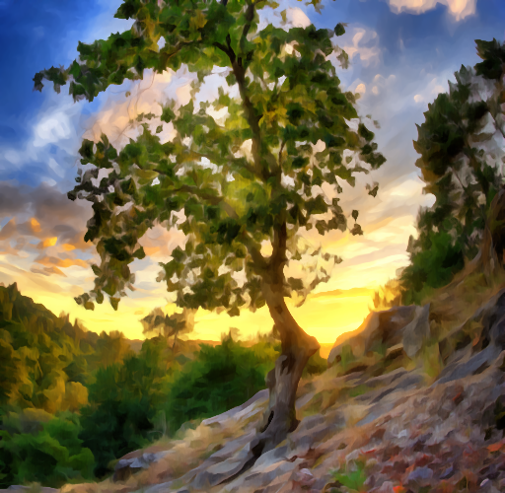
Anisotropic Kuwahara Filtering Kyprianidis et al. (2009)
Further generalization of the Kuwahara filter.
Adaptation of the shape, scale and orientation of the filter to the local image structure.
Original image by Paulo Brandão@flickr.com

Slide 10
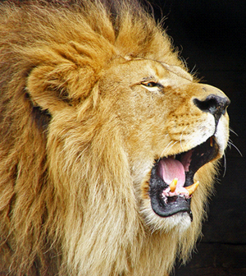
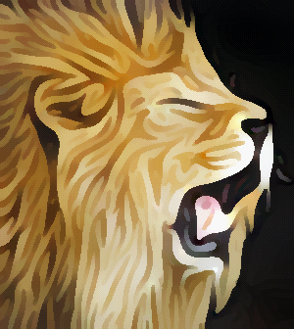
Shape-simplifying Image Abstraction Kang & Lee (2008)
PDE-based technique that simultaneous simplifies colors and shape:
Constrained mean curvature flow
Shock filter
Image credit: Kang & Lee (2008) / original image by Tambako the Jaguar@flickr.com
Input
20 iterations
40 iterations
60 iterations

Slide 11
Difference of Gaussians
Difference of Gaussians:
Laplacian of Gaussian (LoG)
Isotropic Difference of Gaussians (DoG)
Flow-based Difference of Gaussians
Separable Flow-based Difference of Gaussians

Slide 12
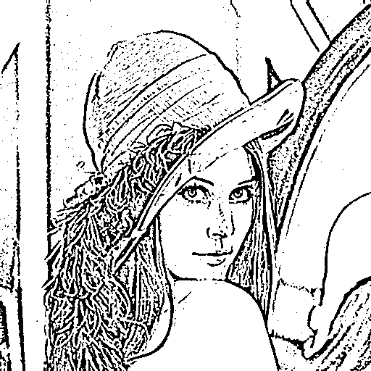
DoG Edges vs Canny Edges
Original image from USC-SIPI Image Database
Canny Edges
Isotropic difference of Gaussians
Flow-based difference of Gaussians

Slide 13
Edge Detection
Edge profile without noise:
Scanline of an image
Edges are located at minima or maxima of the first derivative
First derivative
of scanline
Edges are located at zero crossings of the second derivative
Second derivative
of scanline

Slide 14
Edge Detection
Edge profile with noise:
Scanline of an image with noise
First derivative sensitive
to noise
First derivative
of scanline
Second derivative even more sensitive
to noise
Second derivative
of scanline

Slide 15
Laplacian of Gaussian (LoG) Marr & Hildreth (1980)
In 2D the second derivative corresponds to the Laplacian:
$$L=\frac{∂^{2}f}{∂x^{2}}+\frac{∂^{2}f}{∂y^{2}}$$
Similar to the second derivative the Laplacian is sensitive to noise. To make the Laplacian less sensitive to noise, apply a Gaussian to the image first:
$\text{LoG}=L⋆G_{σ}$ ,
where $G_{σ}$ is a 2D Gaussian with standard deviation $σ$:
$$G_{σ}\left(x,y \right)=\frac{1}{\sqrt{2π}σ}\text{exp}\left(−\frac{x^{2}+y^{2}}{2σ^{2}}\right)$$

Slide 16
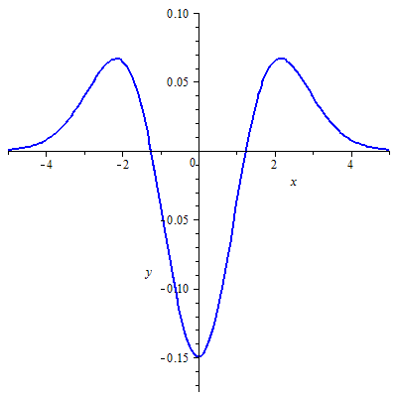
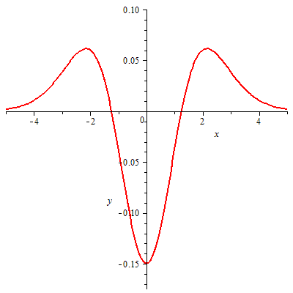
Difference of Gaussians (DoG) Marr & Hildreth (1980)
A Laplacian of Gaussian can be approximated by a difference of Gaussians:
$$\text{LoG}\left(x,y\right)=L⋆G_{σ}$$
$$\text{DoG}(x,y)=G_{σ_{i}}(x,y)−G_{σ_{e}}(x,y)$$
Good engineering solution: ${σ_{i}=1.6⋅σ}_{e}$
Fast to implement since Gaussian
is separable

Slide 17
Difference of Gaussians (DoG) Marr & Hildreth (1980)
Zero-crossing are found by thresholding:

Slide 18
Smooth DoG Edges Winnemöller et al. (2006)
An approach to created smooth edges was proposed by Winnemöller et al.:
$$D(σ_{e}, τ,φ_{e})=\left\{\begin{matrix}1 & \text{if} \left(G_{σ_{e}}−τ G_{1.6⋅σ_{e}}\right)>0 \\ 1+tanh⁡(φ_{e}⋅G_{σ_{e}}−τG_{1.6⋅σ_{e}}) & \text{otherwise} \end{matrix}\right.$$
The parameter $τ$ controls the sensitivity to noise. A typical values are $τ=0.98$ or $τ=0.99$.
The falloff parameter $φ_{e}$ determines the sharpness of edge representations, typical values are $φ_{e}∈[0.75, 5.0]$.

Slide 19
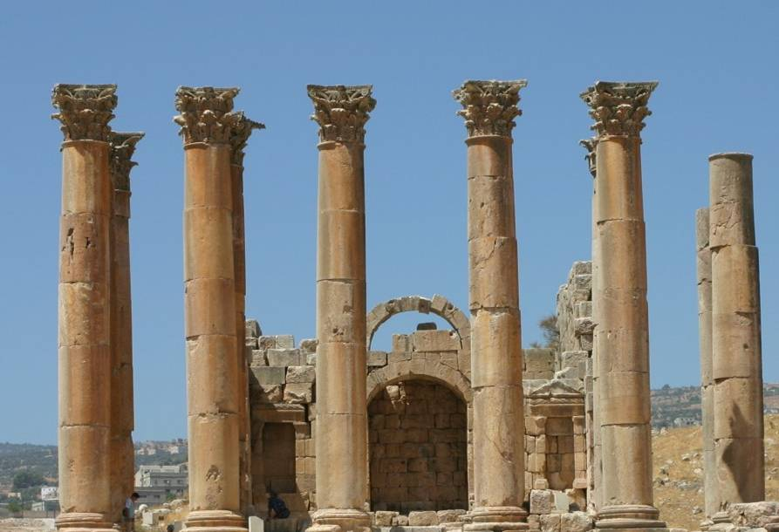
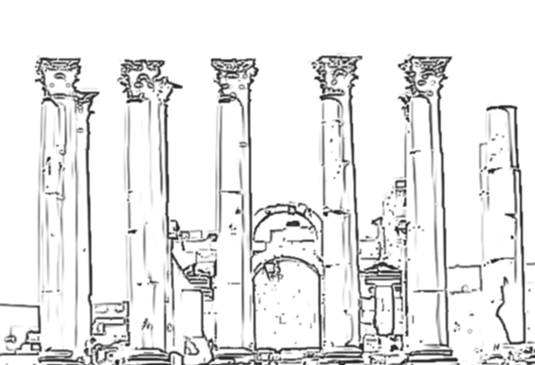
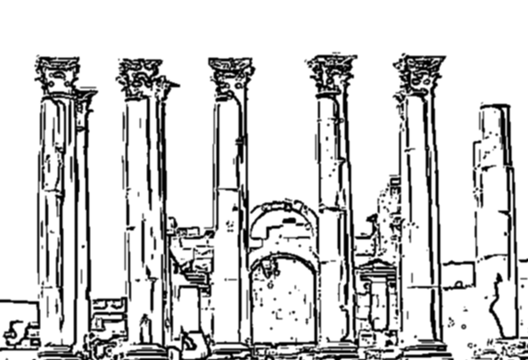
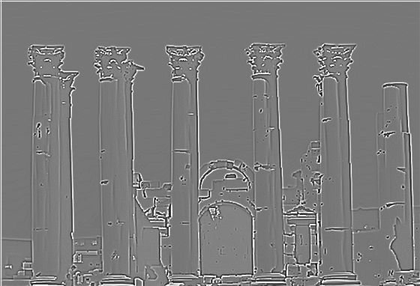
Smooth DoG Edges Winnemöller et al. (2006)
tanh
(half-truncated)
Edge
1
DoG
0
Credit for slide: H. Winnemöller

Slide 20
Difference of Gaussians Guided by Local Image Structure
Local Structure Estimation:
Edge Tangent Flow
Structure Tensor
DoG Guided by Local Image Structure:
Flow-based DoG
Separable flow-based DoG
Original photograph
copyright
Anthony Santella

Slide 21
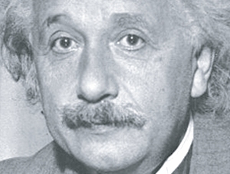
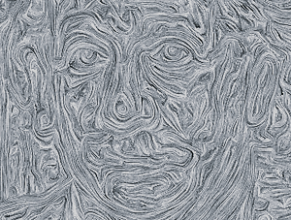
Edge Tangent Flow Kang et al. (2007)
Edge Tangent Flow (ETF):
Smoothly varying vector field
Feature-preserving flow
Image credit: Kang et al. (2007)
Input image
Edge Tangent Flow
Input image
ETF

Slide 22
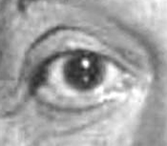
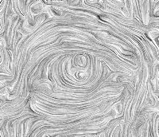
Edge Tangent Flow Kang et al. (2007)
Weighted vector smoothing similar to bilateral filter:
$$t^{n+1}\left(x\right)=\frac{1}{k}\sum_{y∈Ω\left(x\right)}{φ\left(x,y\right)⋅t^{n}\left(y\right)⋅w_{s}\left(x,y\right)⋅w_{m}\left(x,y\right)⋅w_{d}(x,y)}$$
$t^{0}$ is calculated using the
Sobel filter.
Multiple iterations ($≈3)$
Input image
ETF
Image credit: Kang et al. (2007)

Slide 23
Edge Tangent Flow Kang et al. (2007)
$$t^{n+1}\left(x\right)=\frac{1}{k}\sum_{y∈Ω\left(x\right)}{φ\left(x,y\right)⋅t^{n}(y)⋅w_{s}\left(x,y\right)⋅w_{m}\left(x,y\right)⋅w_{d}(x,y)}$$
$$φ\left(x,y\right)=\text{sign}(t^{n}\left(x\right)⋅t^{n}\left(y\right))$$
$$w_{s}\left(x,y\right)=\left\{ \begin{matrix}1 & \left|x−y\right|<r \\ 0 & \text{else}\end{matrix}\right.$$
$$w_{m}\left(x,y\right)=\frac{1}{2}\left[1+tanh⁡\left(|g(x)|−|g(y)|\right)\right]$$
$$w_{d}\left(x,y\right)=\left|t^{n}\left(x\right)⋅t^{n}\left(y\right)\right|$$
Assure different vectors point in the same direction
Restrict filtering to a predefined radius
More weight to vectors with higher gradient magnitude
More weight for vectors with direction similar to current
filter origin
Input image
ETF

Slide 24
Flow-based Difference of Gaussians Kang et al. (2007)
Image credit: Kang et al. (2007)
$$G_{σ_{c}}$$
DoG filter
FDoG
response
$$G_{σ_{s}}$$
$$−T$$
$$0$$
$$T$$

Slide 25
Structure Tensor
Let $f:ℝ^{2}→ℝ^{3}$ denote the input image and let
$$\frac{∂f}{∂x}={\left(\frac{∂R}{∂x} \frac{∂G}{∂x} \frac{∂B}{∂x}\right)}^{t} \frac{∂f}{∂y}={\left(\frac{∂R}{∂y} \frac{∂G}{∂y} \frac{∂B}{∂y}\right)}^{t}$$
be the partial derivatives of $f$.
The structure tensor is then defined by:
$$\left(g_{ij}\right)=J^{t}J=\left(\begin{matrix}\left\langle \frac{∂f}{∂x},\frac{∂f}{∂x}\right\rangle & \left\langle \frac{∂f}{∂x},\frac{∂f}{∂y}\right\rangle \\ \left\langle \frac{∂f}{∂x},\frac{∂f}{∂y}\right\rangle & \left\langle \frac{∂f}{∂y},\frac{∂f}{∂y}\right\rangle \end{matrix}\right)=:\left(\begin{matrix}E & F \\ F & G\end{matrix}\right)$$
These can be implemented for example using Gaussian derivatives or the Sobel filter.
In differential geometry the structure tensor is also known as first fundamental form
The structure tensor is a $2×2$ symmetric positive semidefinte matrix

Slide 26
Structure Tensor
The induced quadratic form of the structure tensor measures the squared rate of change of $f$ in direction of a vector $n=(n_{x},n_{y})$:
$$S\left(n\right)=En_{x}^{2}+2Fn_{x}n_{y}+Gn_{y}^{2}$$
The extremal values of $S\left(n\right)$ on the unit circle correspond to the eigenvalues of $(g_{ij})$:
$$λ_{1,2}=\frac{E+G±\sqrt{{\left(E−G\right)}^{2}+4F^{2}}}{2}$$
The corresponding eigenvectors are:
$$v_{1}=\left(\begin{matrix}F \\ λ_{1}−E\end{matrix}\right) v_{2}=\left(\begin{matrix}λ_{1}−E \\ −F\end{matrix}\right)$$
Eigenvector of major eigenvalue. Direction of maximum change: gradient direction.
Eigenvector of minor eigenvalue. Direction of minimum change: tangent direction.

Slide 27
Structure Tensor
The eigenvectors corresponding to the minor eigenvalues of the structure define a vector field. Typically this field is not smooth:

Slide 28
Smoothed Structure Tensor
Smoothing the structure tensor prior to eigenanalysis with a Gaussian filter removes discontinuities in the vector field:

Slide 29
Smoothed Structure Tensor
Eigenvector field of the smoothed structure tensor is similar to the edge tangent flow, but allows a more efficient implementation:
3 iterations of edge tangent flow filter
Eigenvector field of the smoothed
structure tensor

Slide 30
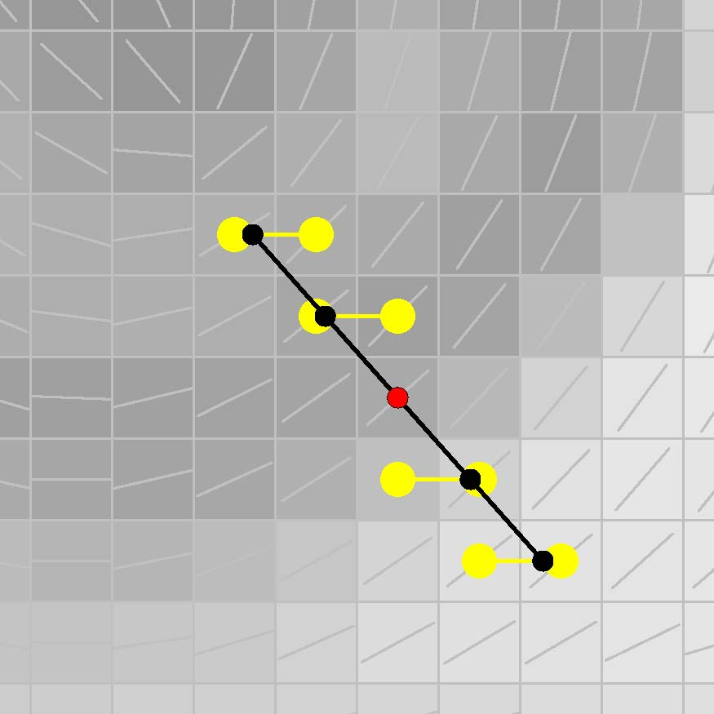
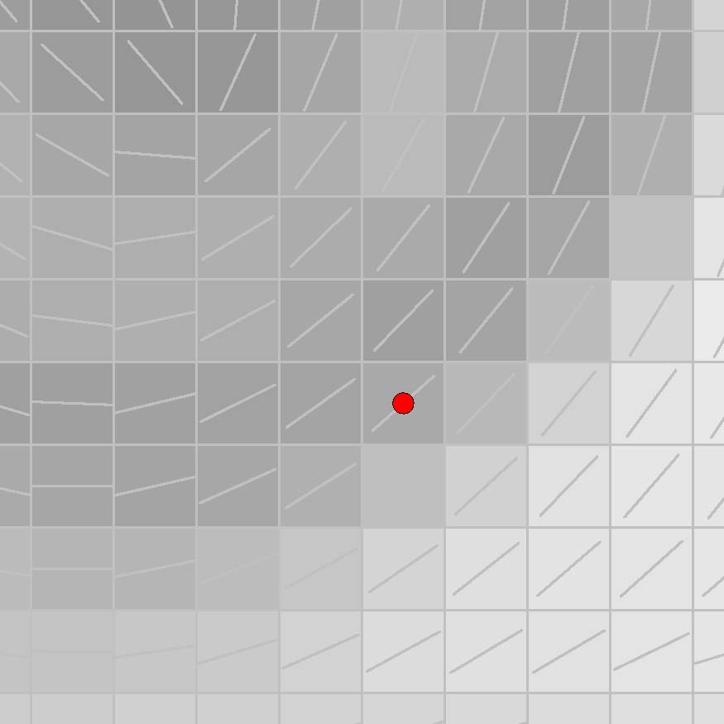
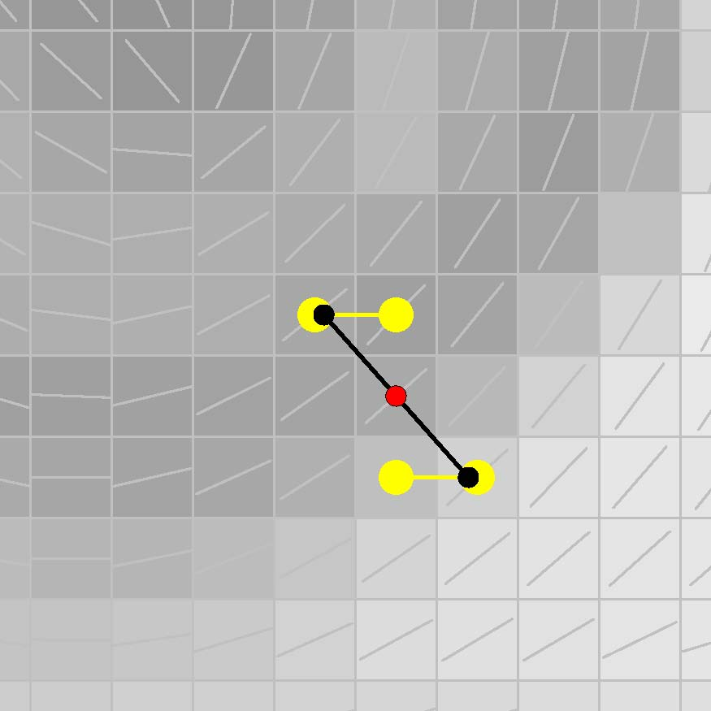
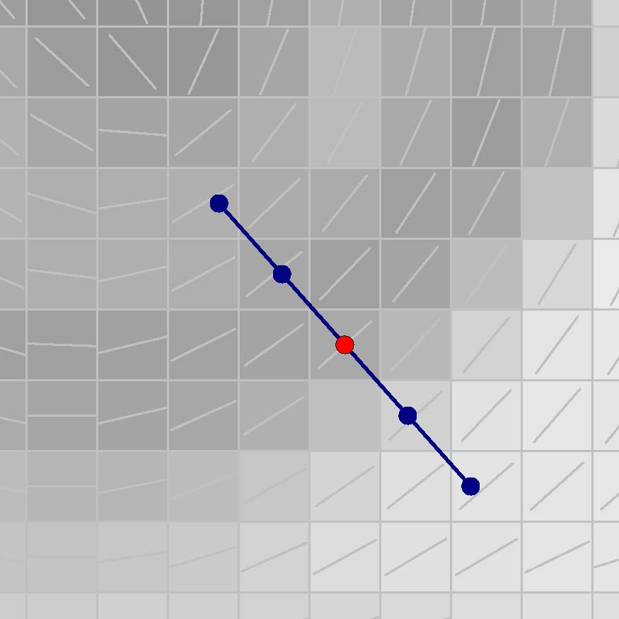
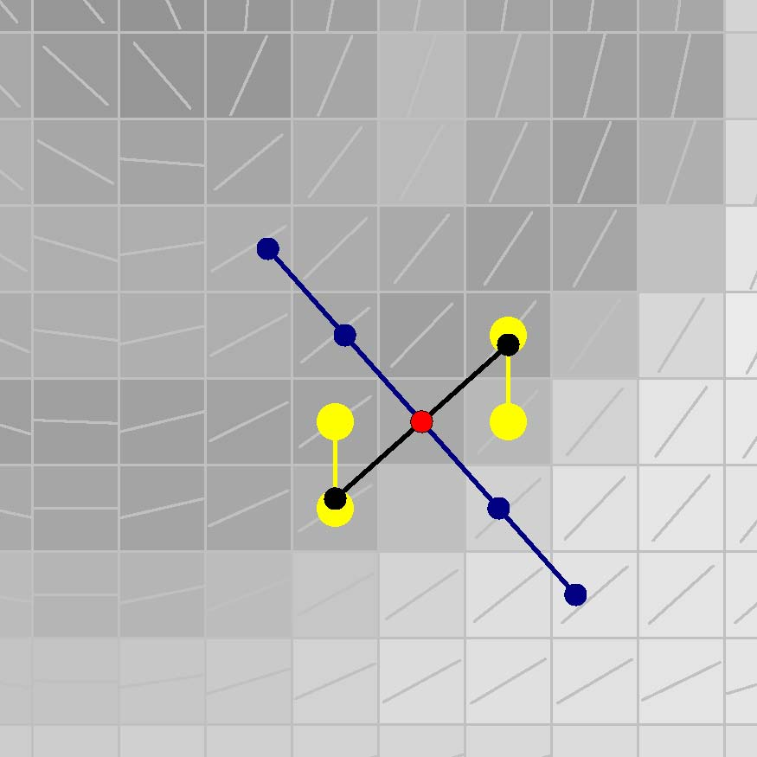
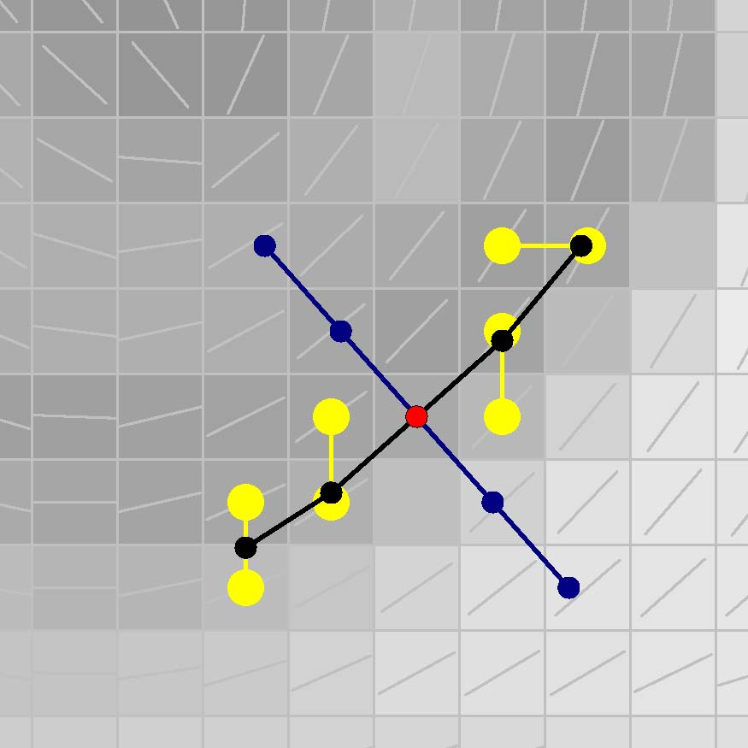
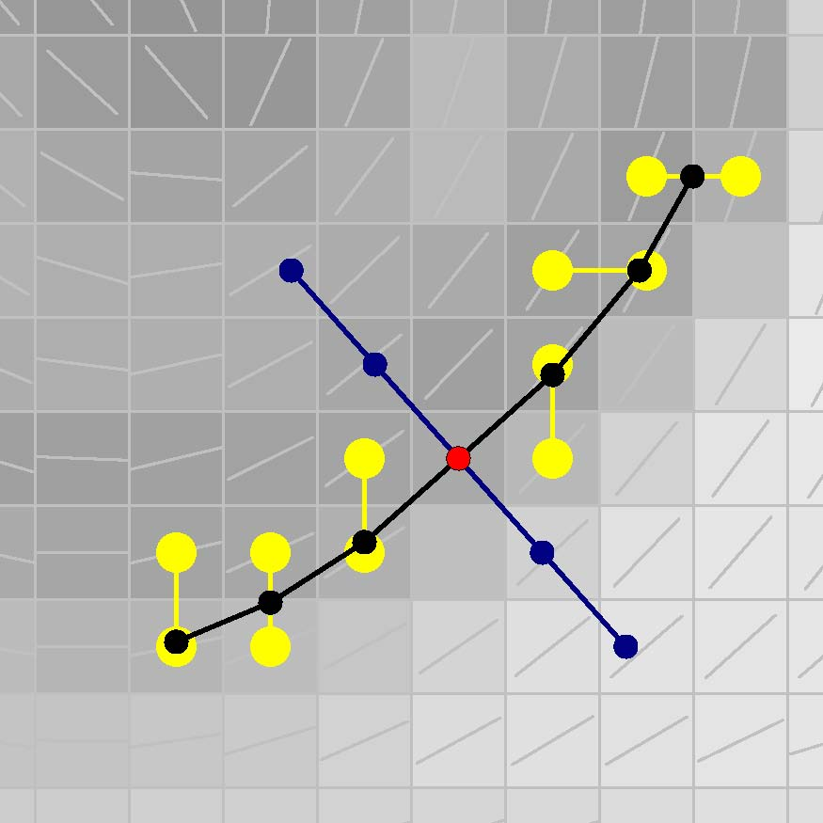
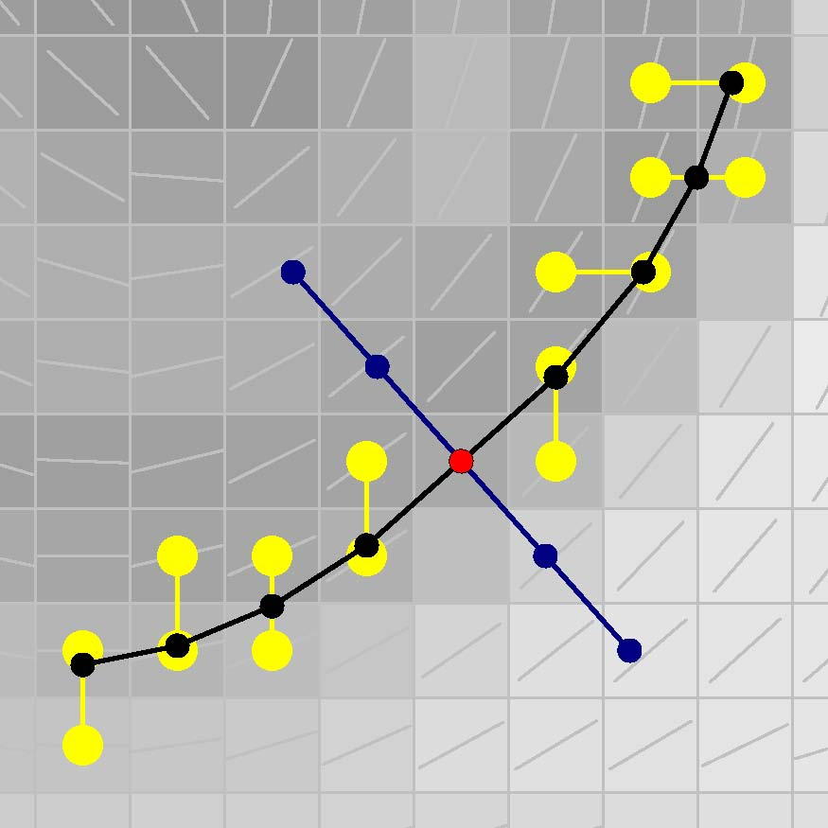
Separable Flow-based Difference of Gaussians Kyprianidis & Döllner (2008)
Split flow-based difference of Gaussians into two passes:
1st Pass: one-dimensional DoG in direction of the major eigenvector
2nd Pass: smoothing along stream lines defined by minor eigenvector
1st Pass
2nd Pass

Slide 31
Bilateral Filter
Bilateral Filter:
Classical Bilateral Filter
xy-Separable Bilateral Filter
Orientation-aligned Bilateral Filter
Flow-based Bilateral Filter

Slide 32
Bilateral Filter Tomasi & Manduchi (1998)
The bilateral filter is a nonlinear operation that smoothes images while preserving edges:
$$\frac{\sum_{x∈B_{r}(x_{0})}{ {f\left(x\right) G}_{σ_{d}}\left(\left|x−x_{0}\right|\right) G_{σ_{r}}\left(\left|f\left(x\right)−f\left(x_{0}\right)\right|\right) }}{\sum_{x∈B_{r}(x_{0})}{ G_{σ_{d}}\left(\left|x−x_{0}\right|\right) G_{σ_{r}}\left(\left|f\left(x\right)−f\left(x_{0}\right)\right|\right) }}$$
$$G_{σ}\left(t\right)=\frac{1}{\sqrt{2π}σ}\exp\left(−\frac{t^{2}}{2σ^{2}}\right)$$
More weight to closer pixel
More weight to pixel with
similar color

Slide 33
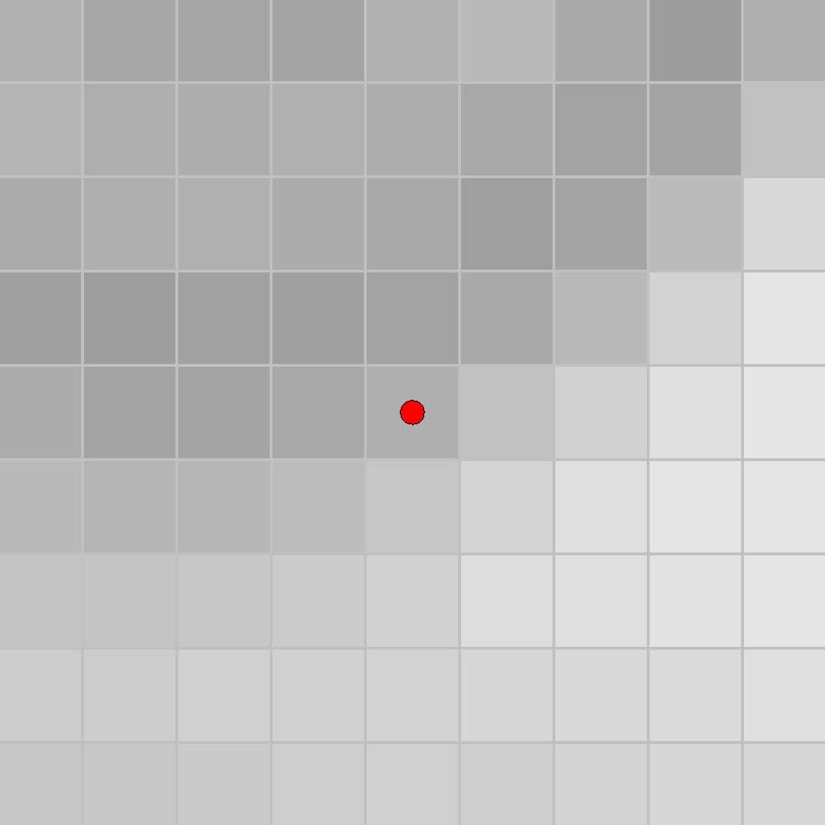
Bilateral Filter Tomasi & Manduchi (1998)
The bilateral filter is a powerful tool, but computationally very expensive ($O\left(r^{2}\right)$ per pixel).

Slide 34
xy-Separable Bilateral Filter Pham & van Vliet (2005)
1st Pass
2nd Pass

Slide 35
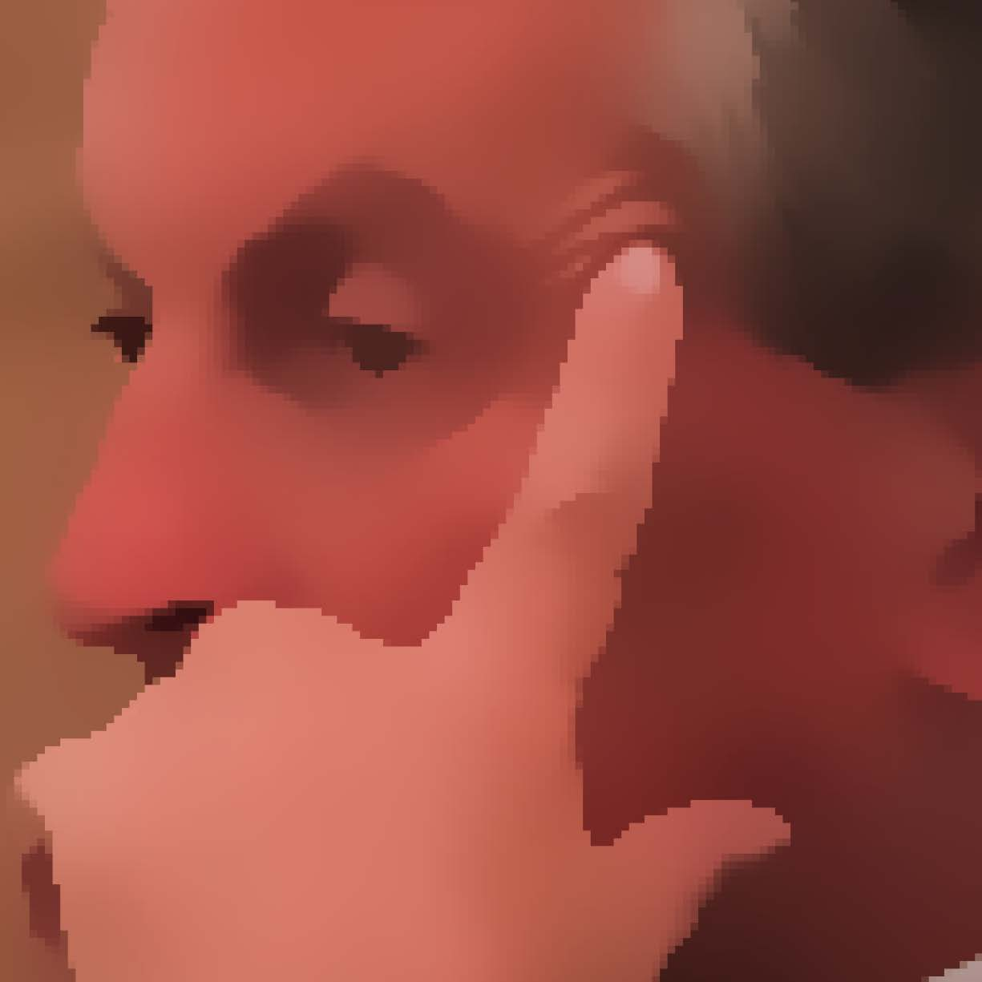
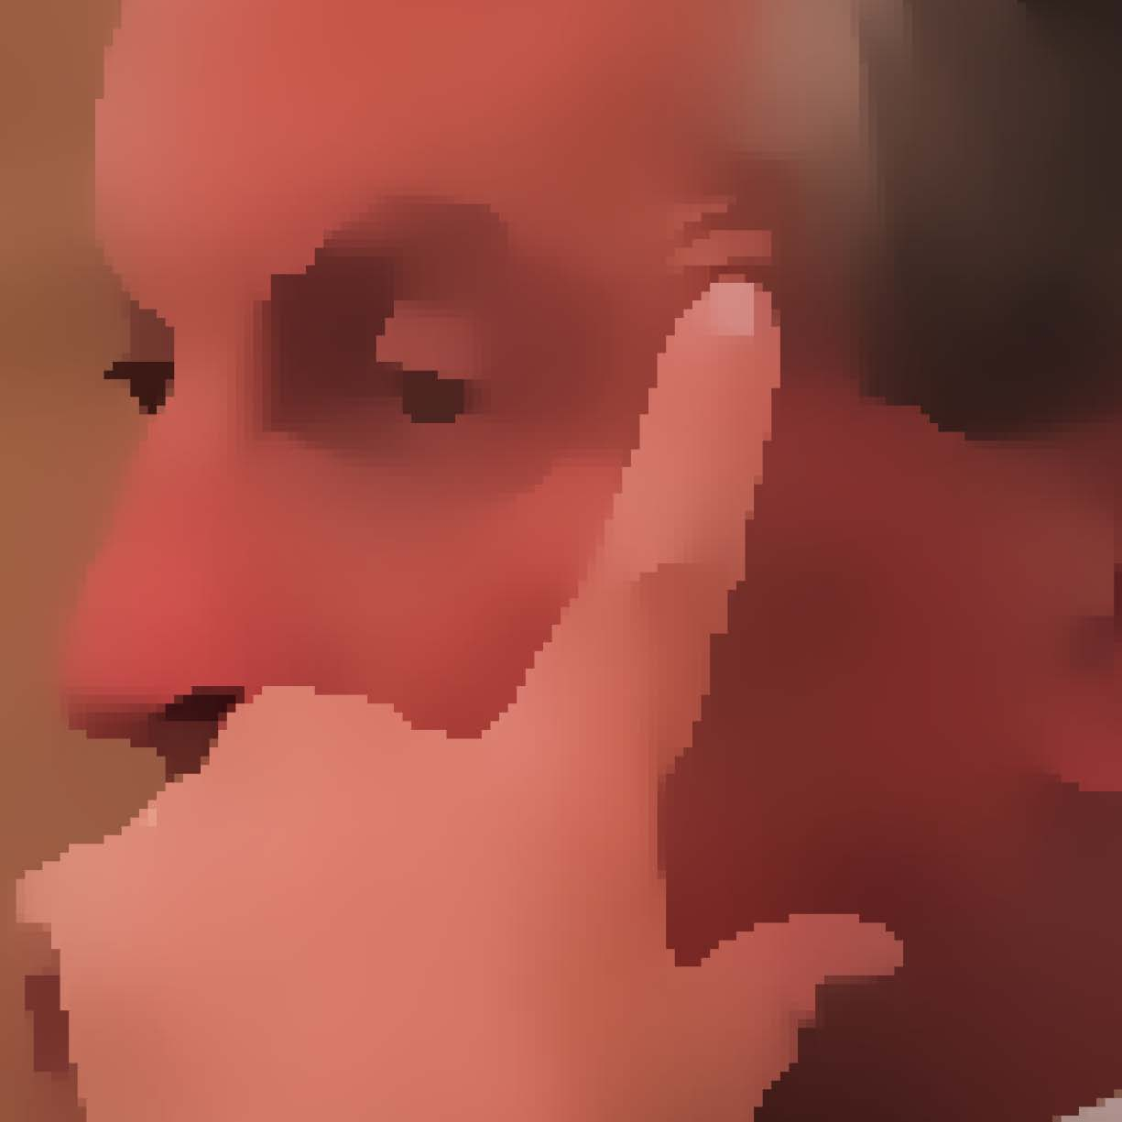
xy-Separable Bilateral Filter Pham (2006)
Much faster than classical bilateral filter
But creates noticeable artifacts!
Full kernel bilateral filter
xy-separable bilateral filter

Slide 36
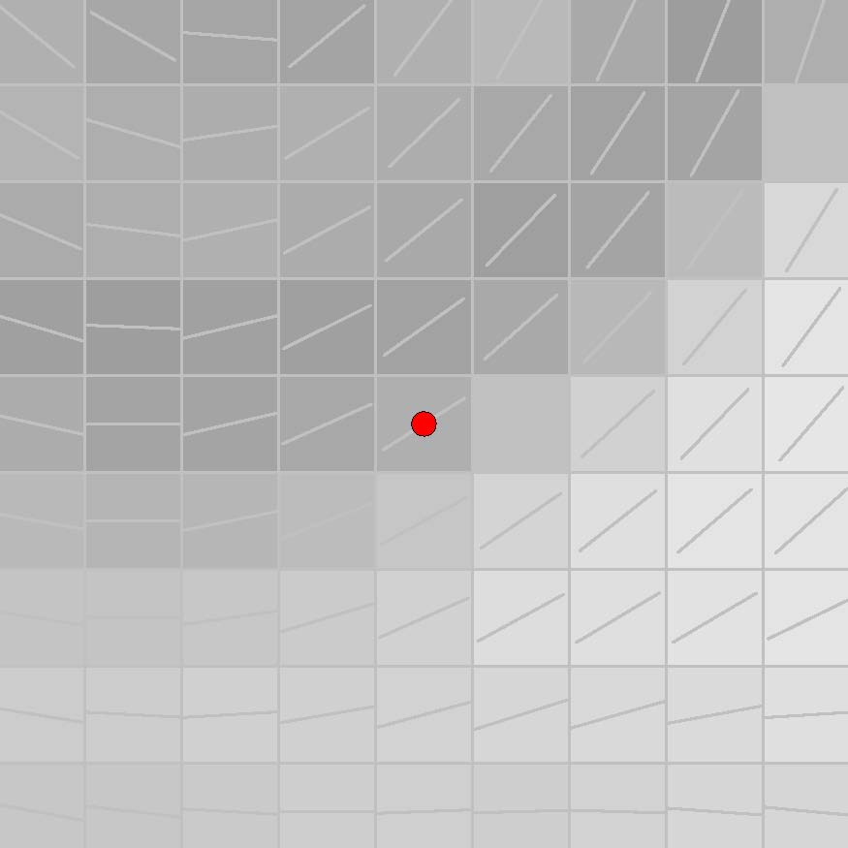
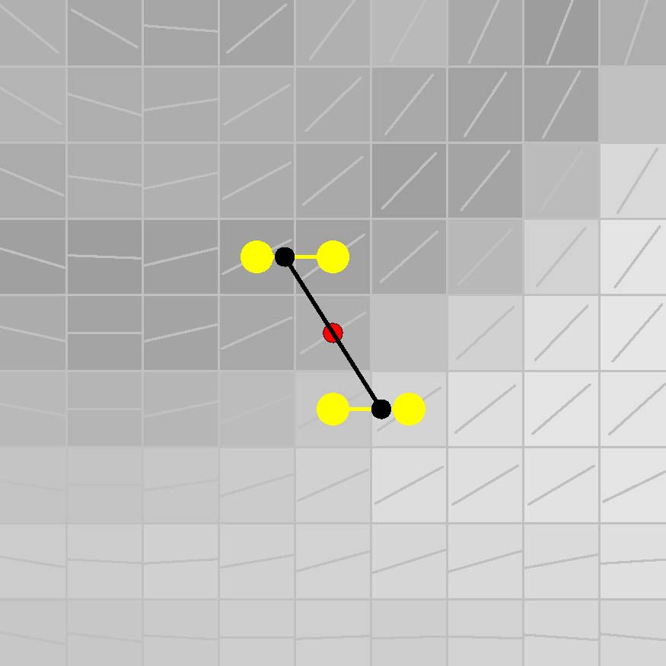
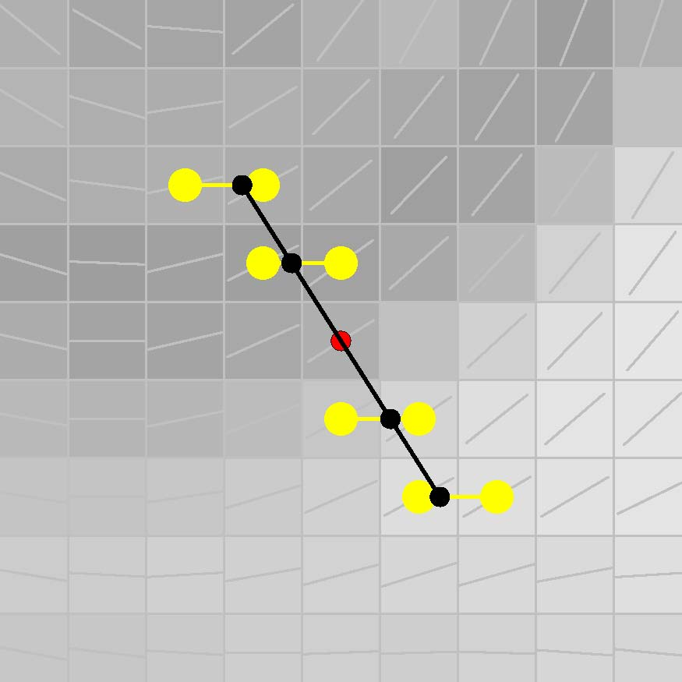
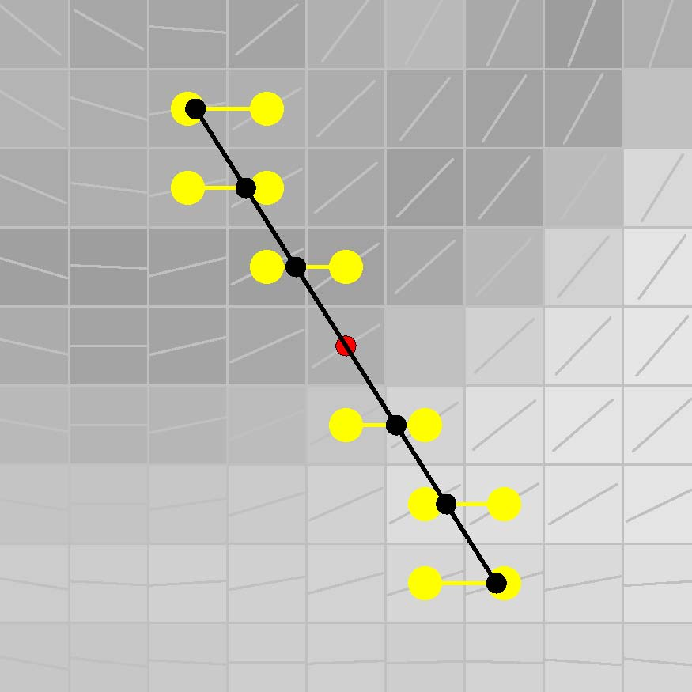
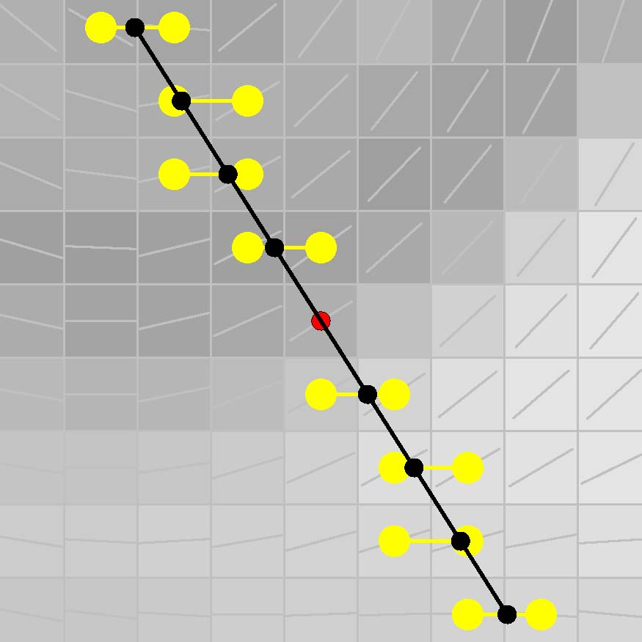
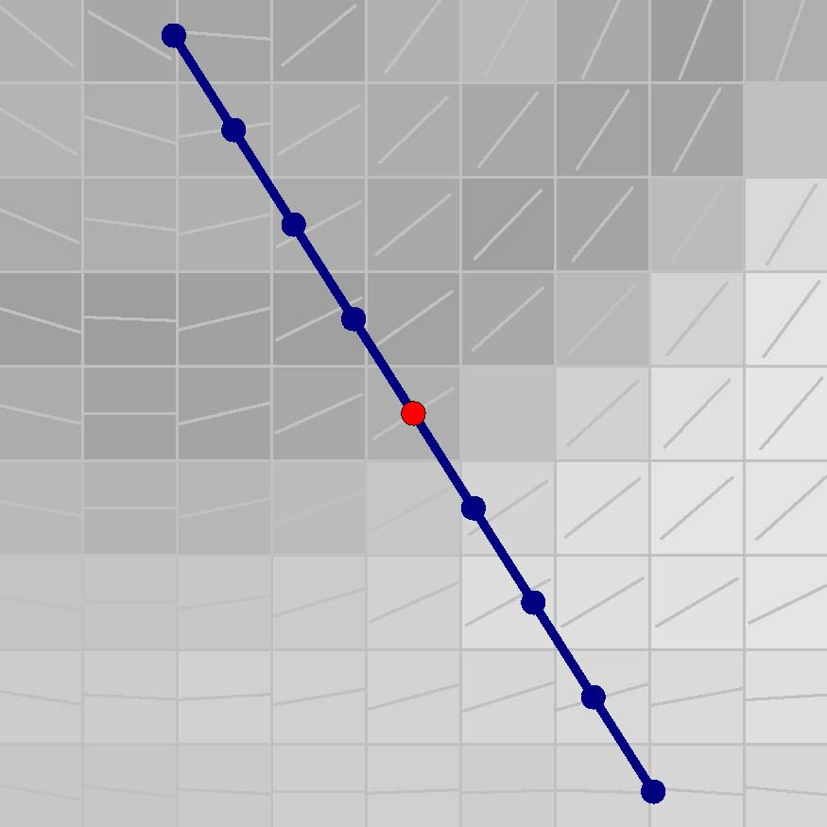
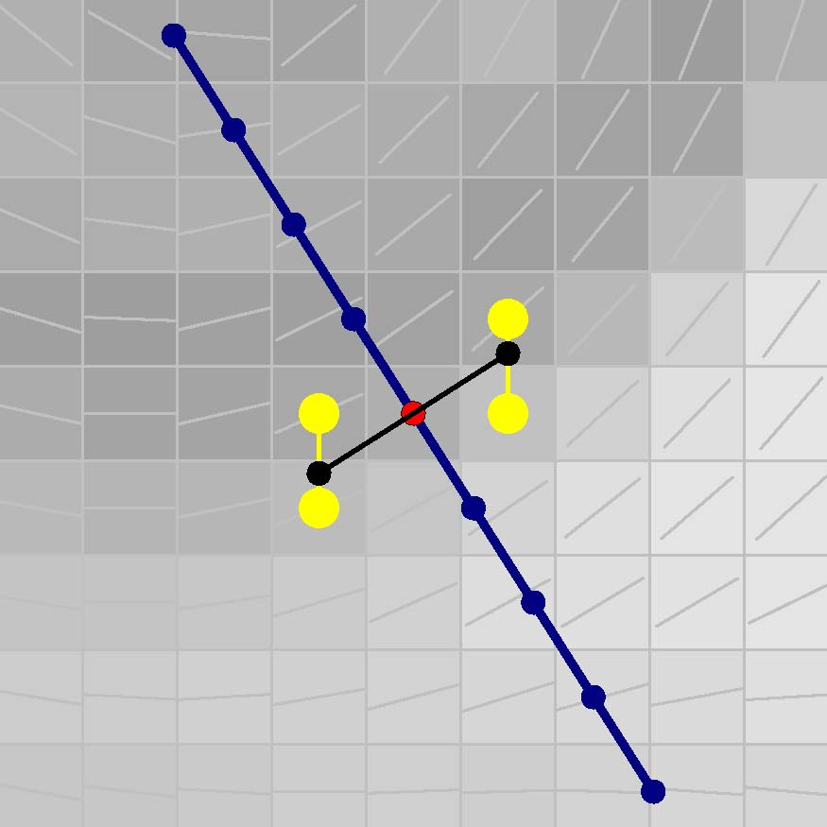
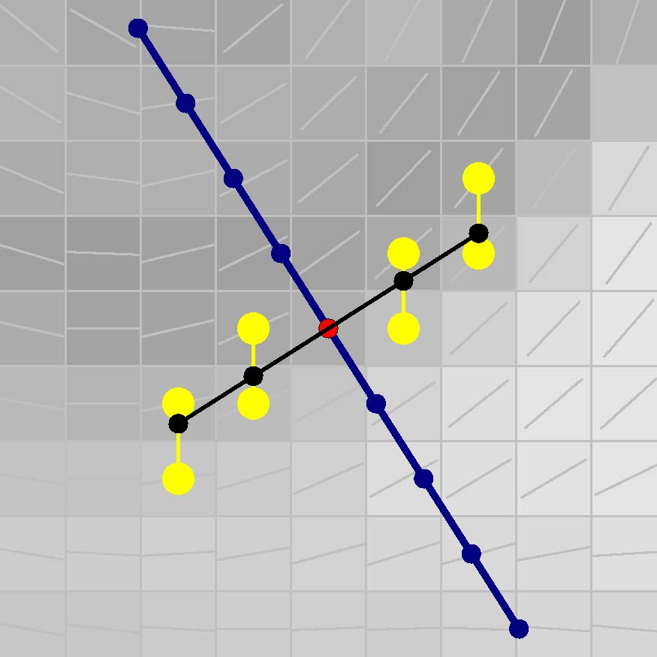
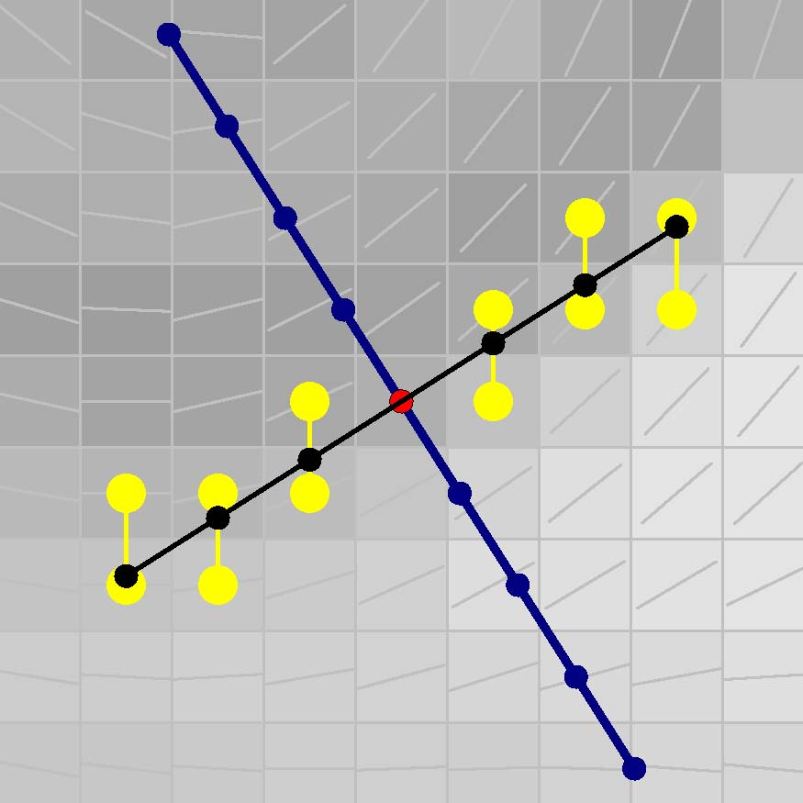
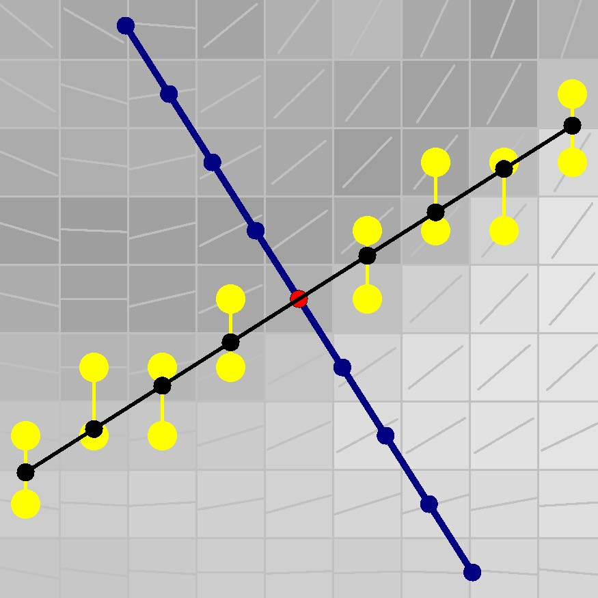
Orientation-aligned Bilateral Filter Kyprianidis & Döllner (2008)
Align separable bilateral filter to local orientation derived from the smoothed structure tensor
1st Pass
2nd Pass

Slide 37
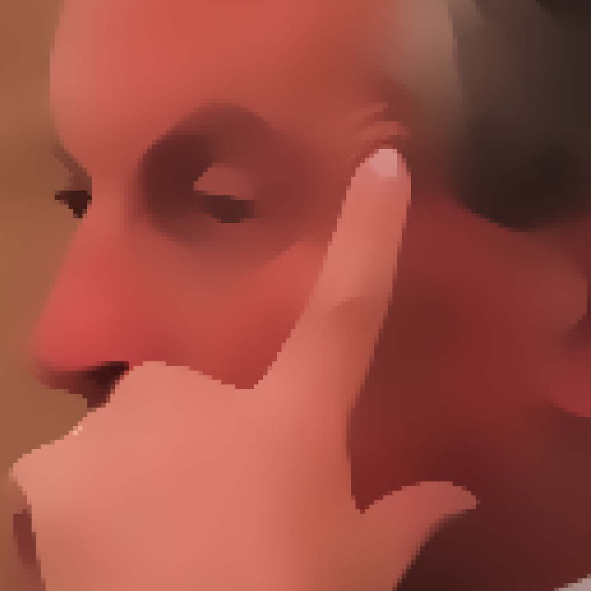
Orientation-aligned Bilateral Filter Kyprianidis & Döllner (2008)
Less artifacts. Very well suited for abstraction.
Full kernel bilateral filter
Orientation-aligned bilateral filter

Slide 38
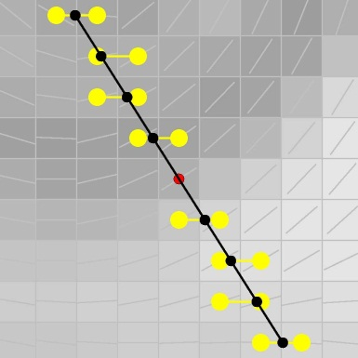
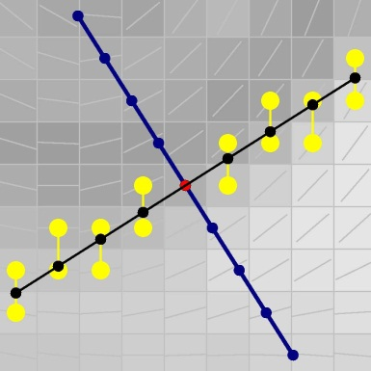
Orientation-aligned Bilateral Filter Kyprianidis & Döllner (2008)
Linear smoothing of neighboring pixel values creates smooth color boundaries
Unit step size either along
x- or y-axis

Slide 39
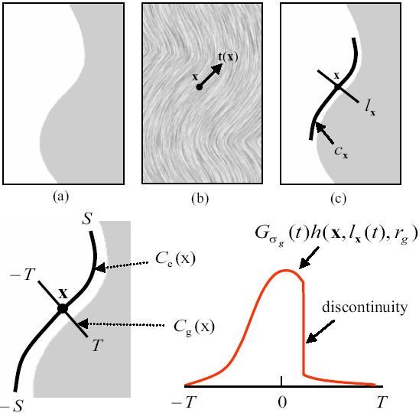
Flow-based Bilateral Filter Kang et al. (2009)
Image credit: Kang et al. (2009)
ETF-guided decomposition of bilateral filter
1st pass in direction of the tangent
2nd pass along stream line defined by
the ETF

Slide 40
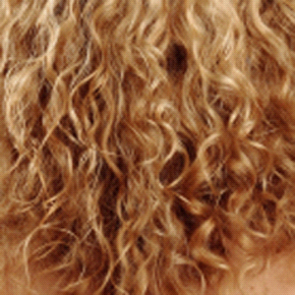
Flow-based Bilateral Filter Kang et al. (2009)
Excellent preservation of highly anisotropic image features
Image credit: Kang et al. (2009)
Input image
Bilateral filter
Flow-based bilateral filter

Slide 41
Color Quantization Winnemöller et al. (2006)

Slide 42
Color Quantization Winnemöller et al. (2006)
Credit for slide: H. Winnemöller
Apply quantization to luminance channel
Input
Result

Slide 43
Color Quantization Winnemöller et al. (2006)
Luminance Mapping
tanh
per bin
Q(.)
…
Hard
q bins
q₂
q
q₁
Soft
Luminance
q₀
Credit for slide: H. Winnemöller

Slide 44
Color Quantization Winnemöller et al. (2006)
Image credit: Winnemöller et al. (2006)
Abstracted
Sharp Quantization
(Toon-like)
Smooth Quantization
(Paint-like)

Slide 45
Kuwahara Filter
Kuwahara Filter:
Classical Kuwahara Filter
Kuwahara Filter with Weighting Functions
Generalized Kuwahara Filter
Anisotropic Kuwahara Filter
Convolution-based Weighting Functions
Polynomial Weighting Functions

Slide 46
Kuwahara Filter
$$W_{0}=\left[x_{0}−r, x_{0}\right]×\left[y_{0},y_{0}+r\right] \\ W_{1}=\left[x_{0}, x_{0}+r\right]×\left[y_{0},y_{0}+r\right] \\ W_{2}=\left[x_{0}, x_{0}+r\right]×\left[y_{0}−r,y_{0}\right] \\ W_{3}=\left[x_{0}−r, x_{0}\right]×[y_{0}−r,y_{0}]$$

Slide 47
Kuwahara Filter
For every subregion $W_{i}$ calculate the mean
$$m_{i}=\frac{1}{|W_{i}|}\sum_{\left(x,y\right)∈W_{i}}{I(x,y)}$$
and the variance:
$$s_{i}^{2}=\frac{1}{\left|W_{i}\right|}\sum_{\left(x,y\right)∈W_{i}}{{\left(I\left(x,y\right)−m_{i}\right)}^{2}}$$
The output of the Kuwahara filter is then defined as the mean of a subregion with minimum variance:
$$F\left(x_{0},y_{0}\right)≔m_{k}, k=\underset{i=0, …, 3}{argmin}{s_{i}}$$

Slide 48
Kuwahara Filter
Kuwahara filter for a corner
Region with small variance. All pixels of this region are similar.
Regions with high variance. They all contain pixels from both color regions.
Result is the mean of the region with minimum variance

Slide 49
Kuwahara Filter
Kuwahara filter for an edge
Region with small variance. All pixels of the region lie on the same side of the edge.
Regions with high variance. They all contain pixels from both sides of the edge.
Result is the mean of the region with minimum variance

Slide 50
Kuwahara Filter
Kuwahara filter for an homogenous neighborhood
All regions have similar variance!
Selection of the region with minimum variance is highly unstable. For example if noise is present.

Slide 51
Kuwahara Filter
Original image by Keven Law@flickr.com

Slide 52
Kuwahara Filter

Slide 53
Kuwahara Filter with Weighting Functions
$$w_{0}$$
$$w_{1}$$
$$w_{2}$$
$$w_{3}$$
$$w_{i}\left(x,y\right)=\left\{ \begin{matrix}1 & \text{if} \left(x,y\right)∈W_{i} \\ 0 & \text{otherwise}\end{matrix}\right.$$

Slide 54
Kuwahara Filter with Weighting Functions
Then the mean is given by:
$$m_{i}=\frac{1 }{\left|W_{i}\right|}\sum_{\left(x,y\right)∈W_{i}}{I(x,y)} \\ =\frac{1}{\left|w_{i}\right|}\sum_{\left(x,y\right)∈ℤ^{2}}{I\left(x,y\right)⋅w_{i}(x−x_{0}, y−y_{0})}$$
And the variance is given by:
$$s_{i}^{2}=\frac{1 }{\left|W_{i}\right|}\sum_{\left(x,y\right)∈W_{i}}{{\left(I\left(x,y\right)−m_{i}\right)}^{2}} \\ =\frac{1}{\left|w_{i}\right|}\sum_{\left(x,y\right)∈ℤ^{2}}{{\left(I\left(x,y\right)−m_{i}\right)}^{2}⋅w_{i}(x−x_{0}, y−y_{0})}$$

Slide 55
Generalized Kuwahara Filter Papari et al. (2007)
Idea: Create smooth weighting functions over a disc those sum is a Gaussian
$$K_{0}$$
$$K_{1}$$
...
$$K_{6}$$
$$K_{7}$$

Slide 56
Generalized Kuwahara Filter Weighting Function Construction
$$χ_{i}\left(x,y\right)=\left\{ \begin{matrix}1 & \frac{\left(2i−1\right)π}{N}<\arg\left(x,y\right)≤\frac{\left(2i+1\right)π}{N} \\ 0 & \frac{0}{0}\text{otherweise}\frac{0}{0}\end{matrix}\right. i=1,…,N−1$$
$$K_{i}={(χ}_{i}⋆G_{σ_{s}})⋅G_{σ_{r}} \\ =K_{0}∘R_{−2πi/N}$$
$$χ_{0}$$
$$χ_{0}⋆G_{σ_{s}}$$
$$\left(χ_{0}⋆G_{σ_{s}}\right)⋅G_{σ_{r}}=:K_{0}$$

Slide 57
Generalized Kuwahara Filter
Then the mean is given by:
$$m_{i}=\frac{1}{\left|K_{i}\right|}\sum_{\left(x,y\right)∈ℤ^{2}}{I\left(x,y\right)⋅K_{i}(x−x_{0}, y−y_{0})}$$
And the variance is given by:
$$s_{i}^{2}=\frac{1}{\left|K_{i}\right|}\sum_{\left(x,y\right)∈ℤ^{2}}{{\left(I\left(x,y\right)−m_{i}\right)}^{2}⋅K_{i}(x−x_{0}, y−y_{0})}$$
The output of the generalized Kuwahara Filter is now defined by:
$$F(x_{0},y_{0})={\sum_{i=0}^{N−1}{s_{i}^{−q}m_{i}} }/{ \sum_{i=0}^{N−1}{s_{i}^{−q}}}$$

Slide 58
Generalized Kuwahara Filter
The parameter $q$ is a tuning parameter that controls the sharpness of color boundaries. A typical value is $q=8.$
$$F\left(x_{0},y_{0}\right)={\sum_{i=0}^{N−1}{s_{i}^{−q}m_{i}} }/{ \sum_{i=0}^{N−1}{s_{i}^{−q}}}$$
Sectors low high variance:
$s_{i}→0⇒s_{i}^{−q}→∞$
(i.e. most influence
to sum)
Sectors with high variance:
$s_{i}≫0⇒s_{i}^{−q}≈0$
(i.e. almost no
influence to sum)

Slide 59
Generalized Kuwahara Filter
Generalized Kuwahara filter for a corner
Sector with small variance. All pixels of this sector are similar. This sector contributes most to the final result
Sectors with high variance. They all contain pixels from both color regions. These sectors have almost no influence.

Slide 60
Generalized Kuwahara Filter
Generalized Kuwahara filter for an edge
Multiple sectors with small variance. All pixels of the sectors lie on the same side of the edge. Result is a weighted sum of the (weighted) mean values of the sectors.
Regions with high variance. They all contain pixels from both sides of the edge. These sector have almost no influence.
Filter shape is similar to a truncated Gaussian

Slide 61
Generalized Kuwahara Filter
Generalized Kuwahara filter for an homogenous neighborhood
All regions have similar variance!
Filter shape is similar to a Gaussian filter

Slide 62
Generalized Kuwahara Filter
Original image by Keven Law@flickr.com

Slide 63
Generalized Kuwahara Filter

Slide 64
Anisotropic Kuwahara Filter Kyprianidis et al. (2009)
...
$$K_{0}$$
$$K_{1}$$
$$K_{6}$$
$$K_{7}$$

Slide 65
Anisotropic Kuwahara Filter Algorithm Overview

Slide 66
Anisotropic Kuwahara Filter Filter Shape Definition
Elliptic filter shape (Pham, 2006)
$$a=\frac{υ+A}{υ} b=\frac{υ}{υ+A}$$
Here, $A∈[0,1]$ denotes the anisotropy measure derived from the structure tensor.
$υ∈(0,∞)$ is a user parameter that controls the eccentricity of the ellipse. A typical choice is $υ=1$.

Slide 67
Anisotropic Kuwahara Filter
Anisotropic Kuwahara filter for a corner
Sector with small variance. All pixels of this sector are similar. This sector contributes most to the final result
Sectors with high variance. They all contain pixels from both color regions. These sectors have almost no influence.
Filter shape is adapted per-pixel

Slide 68
Anisotropic Kuwahara Filter
Anisotropic Kuwahara filter for an edge
Multiple sectors with small variance. All pixels of the sectors lie on the same side of the edge. Result is a weighted sum of the (weighted) mean values of the sectors.
Regions with high variance. They all contain pixels from both sides of the edge. These sector have almost no influence.
Filter shape is adapted to anisotropic image structure

Slide 69
Anisotropic Kuwahara Filter
Anisotropic Kuwahara filter for an homogenous neighborhood
All regions have similar variance!
Filter shape is circular and similar to a Gaussian filter

Slide 70
Anisotropic Kuwahara Filter
Anisotropic Kuwahara filter for a homogenous neighborhood
All regions have similar variance!
Filter shape is similar to a Gaussian filter

Slide 71
Anisotropic Kuwahara Filter
Original image by Keven Law@flickr.com

Slide 72
Anisotropic Kuwahara Filter

Slide 73
Anisotropic Kuwahara Filter Polynomial Weighting Functions
$$\left(x+ζ\right)−ηy^{2}$$
$${\left(\left(x+ζ\right)−ηy^{2}\right)}^{2}$$
$$\text{max}\left\{0,{\left(\left(x+ζ\right)−ηy^{2}\right)}^{2}\right\}≔k_{0}$$
$${\tilde{k}}_{0}\left(x,y\right)=\frac{k_{0}}{\sum_{i}{k_{i}\left(x,y\right)}}$$
${\tilde{K}}_{0}={\tilde{k}}_{0}⋅G_{σ_{s}}$

Slide 74
Shape-simplifying Image Abstraction Kang & Lee (2008)
Mean curvature flow (Alvarez et al., 1992):
$$I_{t}=κ |∇I|$$
Curvature
Image gradient
-
+
Decreasing the intensity here moves the level curve
Increasing the intensity here moves the level curve
-
+

Slide 75
Shape-simplifying Image Abstraction Kang & Lee (2008)
Mean curvature flow
Image credit: Kang & Lee (2008)
Input
20 iterations
60 iterations

Slide 76
Shape-simplifying Image Abstraction Kang & Lee (2008)
Shock filter (Osher and Rudin, 1990; Alvarez and Mazorra 1994):
$$I_{t}=−sign\left(∆G_{σ}⋆I\right) |∇I|$$
In the influence zone of a maximum, the Laplacian $∆I$ is negative and, therefore,
a dilation is performed.
In the influence zone of a minimum,
the Laplacian $∆I$ is positive, which results in an erosion.
Image credit: Kang & Lee (2008)
Input
Influence zones
Output

Slide 77
Shape-simplifying Image Abstraction Kang & Lee (2008)

Slide 78
Shape-simplifying Image Abstraction Kang & Lee (2008)
Image abstraction by mean curvature flow
Image credit: Kang & Lee (2008)
Input
20 iterations
60 iterations

Slide 79
Shape-simplifying Image Abstraction Kang & Lee (2008)
Constrained mean curvature flow:
$$I_{t}=s⋅κ \left|∇I\right|$$
with
$$s\left(x\right)=\left|t\left(x\right)⋅∇I\left(x\right)\right|$$
Stop diffusion if grafient is not aligned to edge tangent flow (ETF)
Edge tangent
flow (ETF)
Image gradient

Slide 80
Shape-simplifying Image Abstraction Kang & Lee (2008)

Slide 81
Shape-simplifying Image Abstraction Kang & Lee (2008)
Image abstraction by constrained mean curvature flow
Image credit: Kang & Lee (2008)
Input
60 iterations image abstraction by MCF
60 iterations image abstraction by CMCF

