Slide 1
Artistic Stylization of Images and Video Part II – Vision for Stylisation Eurographics 2011
John Collomosse
Centre for Vision Speech and Signal Processing (CVSSP),
University of Surrey, United Kingdom
http://kahlan.eps.surrey.ac.uk/EG2011

Slide 2
References
Visual Interest and NPR: an Evaluation and Manifesto
A. Santella and D. DeCarlo, NPAR 2004
Stylization and Abstraction of Photographs
D. Decarlo, A. Santella, SIGGRAPH 2002
Segmentation-based 3D Artistic Rendering
A. Kolliopoulos, J. Wang, A. Hertzmann, EGSR 2006.
Synergism in Low Level Vision (EDISON)
C. Christoudias, B. Georgescu, P. Meer, ICPR 2002.
SIFT flow: dense correspondence across difference scenes
C. Liu, J. Yuen, A. Torralba, J. Sivic, W. Freeman, ECCV 2008.
High Accuracy Optical Flow Estimation Based on a Theory for Warping
T. Brox, A. Bruhn, N Papenberg, J. Weickert, ECCV 2004.
What dreams may come (movie)
Dir. V. Ward. Universal. 1998.
Non-photorealistic Rendering SIGGRAPH Course notes
D. Green, SIGGRAPH 1999
Processing Images and Video for Impressionist Effect
P. Litwinowicz, SIGGRAPH 1997
Video Tooning
J. Wang , Y. Xu, H. Shum, M. Cohen, SIGGRAPH 2004

Slide 3
References
Painterly Rendering for Video and Interaction
A. Hertzmann, K. Perlin. NPAR 2000.
Painterly Rendering for Animation
B. Meier. SIGGRAPH 1996
Image Analogies
A. Hertzmann, C. Jacobs, N. Oliver, B. Curless, D. Salesin. SIGGRAPH 2001
Directional Texture Transfer
H. Lee, S. Seo, S. Ryoo, K. Yoon. NPAR 2010.
Empathic Painting: Interative stylization using observed emotional state
M. Shugrina, M. Betke, J. Collomosse. NPAR 2006.
Genetic Paint: A Search for Salient Paintings
J. Collomosse, P. Hall. EvoMUSART 2005 (J. IJAIT 2006).
The Art of Scale Space
J. A. Bangham, S. Gibson, R. Harvey. BMVC 2003.
Visual interest and NPR: An evaluation and manifesto
A. Santella, D. DeCarlo. NPAR 2004.
Segmentation-based 3D Artistic Rendering
A. Kolliopoulos, J. Wang, A. Hertzmann. EGSR 2006.
Stylized Video Cubes
A. Klein, P. Sloan, A. Colburn, A. Finkelstein, M. Cohen. EG SCA 2002.
Image and Video based Painterly Animation
J. Hayes and I. Essa, NPAR 2004.

Slide 4
References
Stroke Surfaces: Temporally Coherent Artistic Animations from Video
J. Collomosse, D. Rowntree, P. Hall. IEEE TVCG 2005.
Video Watercolorization using Bidirectional Texture Advection
A. Bousseau, D. Neyret, J. Thollot, D. Salesin
Video Analysis for Cartoon-like Special Effects
J. Collomosse, D. Rowntree, P. Hall. BMVC 2003.
Video Analysis for Dynamic cues and Futurist Art
J. Collomosse, P. Hall. Graphical Models. 2006.
Motion Magnification
C. Liu, A. Torralba, W. Freeman, F. Durand, E. Adelson. SIGGRAPH 2005
Video SnapCut: Robust Video Object Cutout Using Localized Classifiers
X. Bai, J. Wang, D. Simons, G. Saprio. SIGGRAPH 2009
Stylized Displays of Home Image and Video Collections
T. Wang, R. Hu, J. Collomosse, D. Slatter, P. Cheatle, D. Greig. NPAR 2010 (CAG 2011)
Painterly animation using video semantics and feature correspondence
L. Liang, K. Zeng, H. Lv, Y. Wang, Q. Xu, S. Zhu. NPAR 2010
From Image Parsing to Painterly Rendering
K. Zeng, M. Zhao, C. Xiong, S. Zhu. ACM ToG 2010.

Slide 5
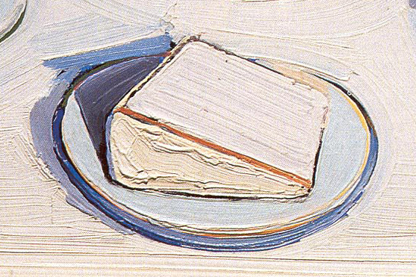
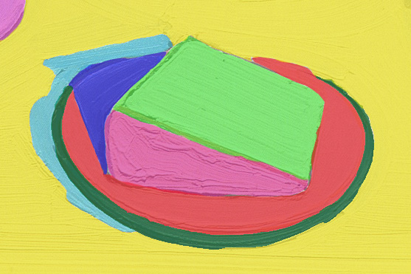
Higher Level Visual Analysis
Region-based discrimination
Artistic Stylization pre-2000
Dependent on low-level image processing (e.g. Sobel) to drive preservation of local edge and high frequency content.
An Artist does not paint a stroke by looking only at the image content under that stroke
A higher level of visual analysis is needed:
Consider more than local edge information
Global analysis vs. greedy placement
Computer Vision and Optimisation are solutions
Around the Cake (Thiebaud‘62). Markup (Kolliopoulos ’06)

Slide 6
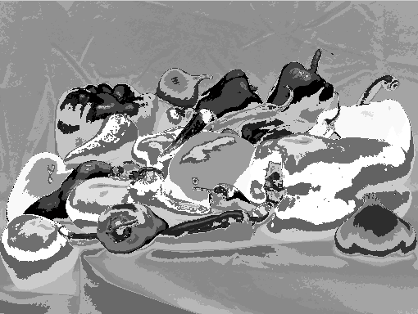
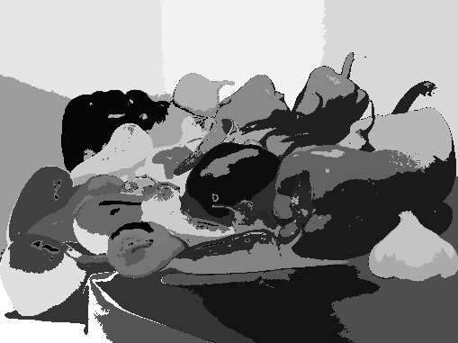
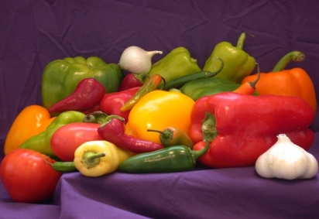
Mean-shift Segmentation
Mean-shift is the defacto choice for most NPR/segmentation techniques
Unsupervised clustering in (x,y,r,g,b)
Red
Y
X
Blue
Green

Slide 7
Mean-shift Segmentation
Mean-shift is the defacto choice for most NPR/segmentation techniques
Maximise density
of points within kernel
Unsupervised clustering in (x,y,r,g,b)
Red
Y
X
Blue
Green

Slide 8
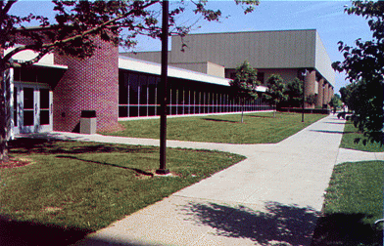
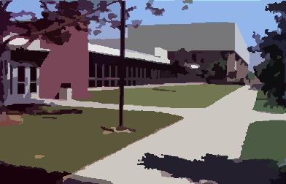
Mean-shift Segmentation
Kernel choices
Typical segmentation result
Rectangular Gaussian
Parzan function (h=bandwidth)
Mean shift vector is weighted summation
Overlapping windows can combine

Slide 9
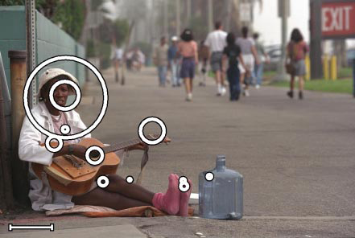
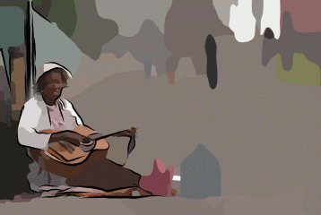
Stylization and Abstraction of Photographs
Decarlo and Santella. (2002)
Segmentation (Mean-Shift) [Christoudias et al, ICPR 2002]
Create a spatial hierarchy of regions
Strokes painted in a region have same prominence
Or render regions flat with black edges to create ‘toon effect
Determine prominence of regions interactively
…using an eye tracker
Black “Inking” effect via vectorised Canny edge map
Gaze Fixations

Slide 10
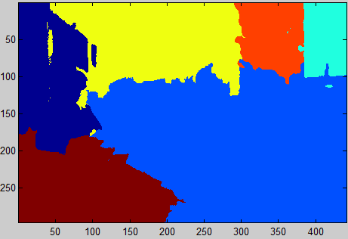
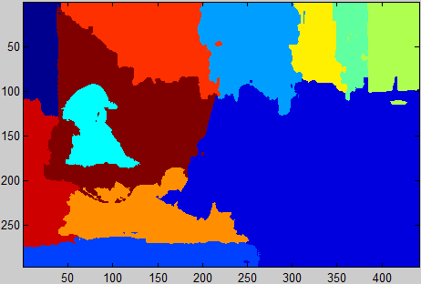
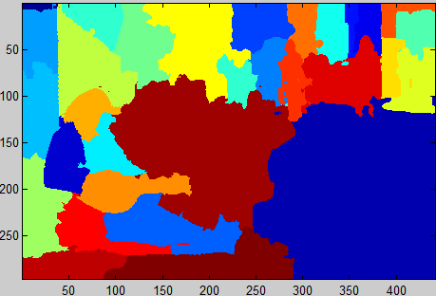
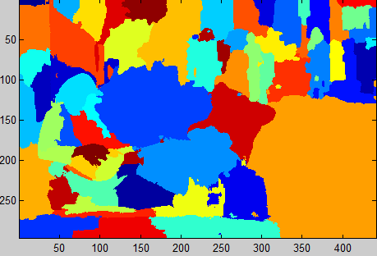
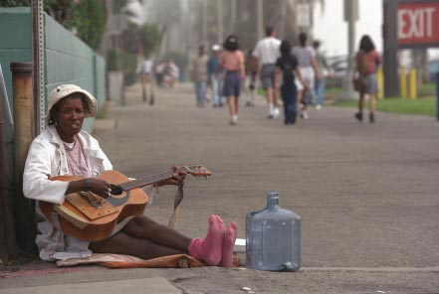
Stylization and Abstraction of Photographs Implementation Steps
Segment levels of low-pass (Gaussian) pyramid
DeCarlo uses factor of σ between layers
Discard regions < 500 pixels (on 640x480 image)
Grouping
Segments grouped into hierarchy from fine to coarse based on overlap and common colour
L2
L1
1. For each* region A at the current level e.g. L1
2. Find the region Bi in level above e.g. L2 maximising:
3. Assign A’s parent to Bi, providing is contiguous+
*At step 1, iterate through regions in order of increasing area.
+ After all levels are processed, any orphan regions become children of root note.

Slide 11
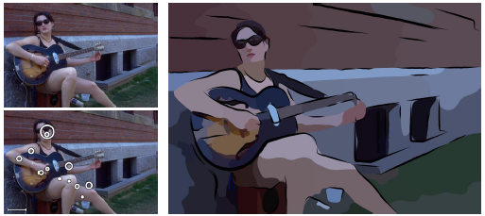
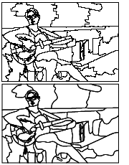
Stylization and Abstraction of Photographs
Decarlo and Santella. (2002)
Region detail identified via fixation
Post-smoothing
Painting starts at the coarsest level of region detail
A region is split if more than half its children are fixated upon
The resulting region map is noisy, but aesthetics improve after smoothing and vectorisation

Slide 12
Sieves Bangham et al. (2003)
Alternative scale-space hierarchy using sieves
Morphological operations (closure followed by opening)
X=imerode(imdilate(X,ones(1,N)),ones(1,N));
X
Original 1D signal
X at N=2
...grouping
X at N=3
...no change
X at N=4
...grouping
X at N=5
...root

Slide 13
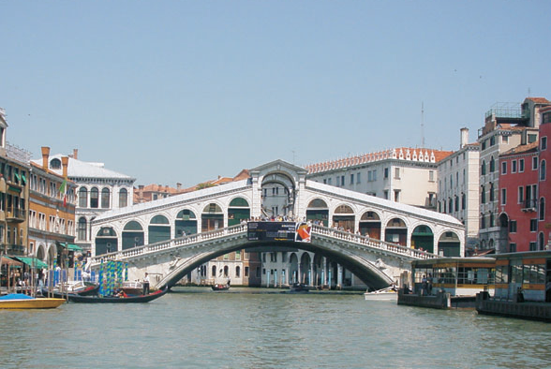
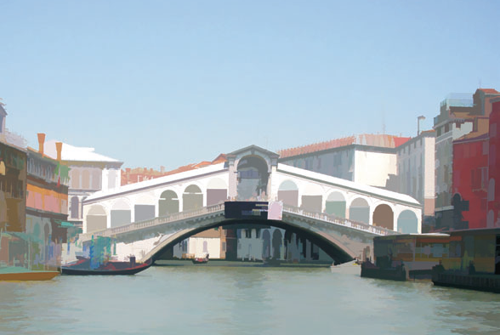
The Art of Scale Space (Sieves) Bangham et al. (2003)
Sieves better preserve edges/corners vs. Gaussian
Extended to 2D in [Bangham ‘99], NPR application [Bangham ’03]. Colour sieves (Harvey ‘04)
Similar level of detail strategy to Decarlo/Santella can be applied to scale-space tree

Slide 14
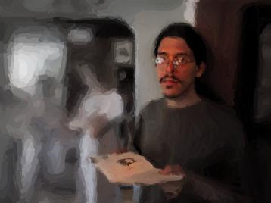
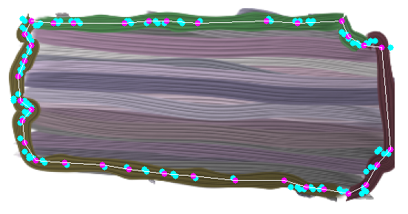
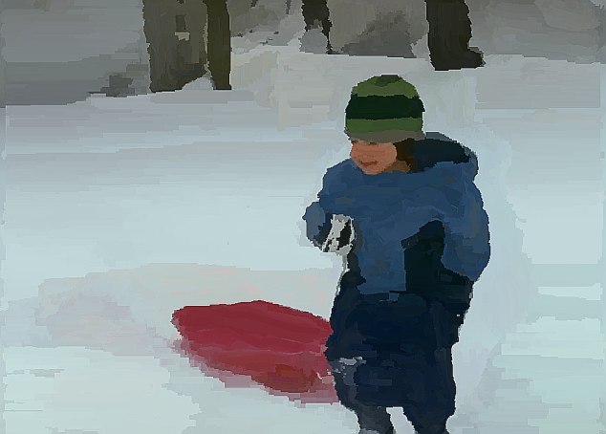
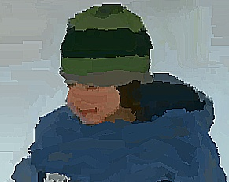
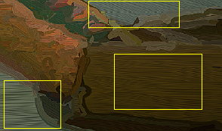
Region based Painting
Painting the regions
Paint via 3rd party algorithm e.g. Hertzmann with constant stroke size [Santella /DeCarlo NPAR’02]
Fill region with strokes in direction of principal axis [Shugrina et al, NPAR ‘06]
Fill with strokes in directions derived from region exterior contour [Wang et al, NPAR ‘10]
c.f. video painting...

Slide 15
Poisson Filling Perez et al. (2003)
Interpolating orientations (from boundaries where M(x,y)=1)
Constrained gradient:
, where
I.e. which can be solved n x n sparse linear system
1 0 0 0 0 0 0
p₁
G₁
...
p₂
=
Known pixels
...
G₂
0 1 0 0 0 0 0
1 1 -4 1 1 0 0
p₃
0
Unknown pixels
...
...
...
p_{n}
G_{n}

Slide 16
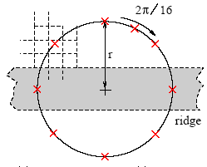
Genetic Paint: Search for Salient Paintings Collomosse et al. 2005.
Automated Differential Emphasis in Painting
Prescriptive salience measures [Itti & Koch]
Not closely correlated to human behaviour [Santella/DeCarlo NPAR’04]
Salience is subjective and task dependent
Trainable measure of salience (GMM of radial features)
Rarity & Visibility Radial Features

Slide 17
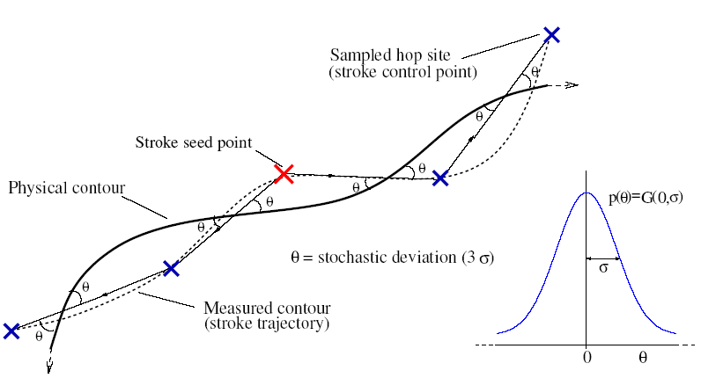
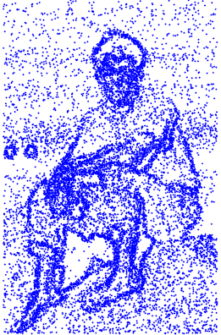
Genetic Paint: Search for Salient Paintings Collomosse et al. 2005.
Genetic Optimisation to find “best” painting
The optimal painting preserves detail in salient areas, and removes non-salient detail
MSE between salience map and Sobel edge detail in the painting (c.f. Hertzmann ‘01)

Slide 18
Genetic Paint: Search for Salient Paintings Collomosse et al. 2005.
Paintings are bred by cloning strokes from two individuals
(Two parent cross-over)
fitness proportionate selection with replacement
Promotion of rapid convergence
Top 10% carried over to next gen. automatically
Bottom 10% culled

Slide 19
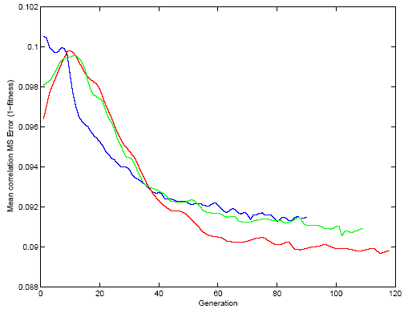
Genetic Paint: Search for Salient Paintings Collomosse et al. 2005.
Iterative optimization improves detail in salient regions
Population of ~50 paintings
Convergence in ~200 iterations
Stochastic variation in stroke attributes creates diversity
GA combines favourable regions of parent paintings

Slide 20
Genetic Paint: Search for Salient Paintings Collomosse et al. 2005.
Close-up on next slide
Manually dampened salience map for illustration

Slide 21
Comparison of Salience vs. Edge based Painting
Comparison of Sobel-driven and Salience-driven painting
Detail on the sign is preferentially retained (wrt. Leaves of the tree)
Not all edges / high frequency texture are salient
Original
Litwinowicz ‘97
Salience driven

Slide 22
Painting Code
Painting research code available
http://kahlan.eps.surrey.ac.uk/EG2011
MATLAB based (experiment with different salience maps)
Code adapted from Collomosse et al. 2005 – single iteration, spline strokes.
Previously released as lab exercise at EPSRC VVG Summer School (2007)

Slide 23
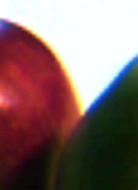
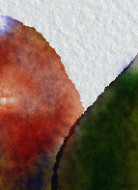
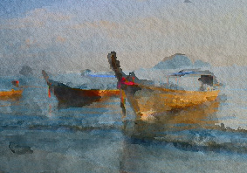
Image Analogies Hertzmann et al. (2001)
Style Transfer
Learning vs Heuristic approach to stylise photos
Patch based lookup (luminance only)
Similar to Freeman texture synthesis but using external collection of patches
Learned as lookup table
Learn
Apply
Key
Value
PCA
. . .
. . .

Slide 24
Image Analogies Hertzmann et al. (2001)
Style Transfer
Synthesis has ‘data’ and ‘smoothness’ terms
Data (patch lookup)
Pixel-wise luminance comparison (after PCA)
Smoothness (derived from Ashikhmin)
Minimise MSE between proposed patch and existing neighbours
Gaussian weighted distance function (avoids discontinuity)
Key
Value
?
ANN
. . .
. . .

Slide 25
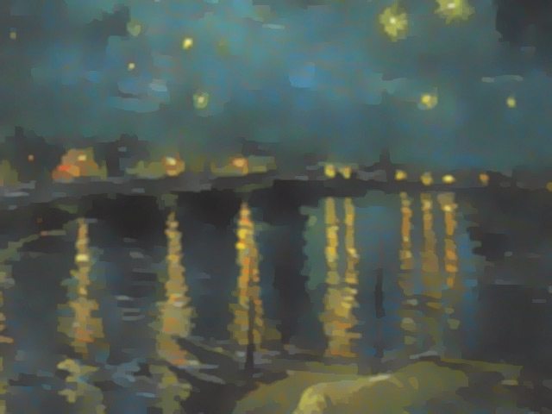
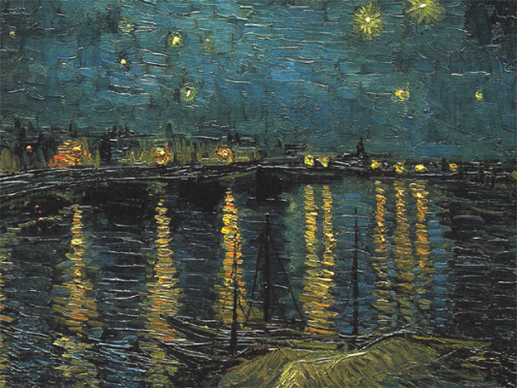
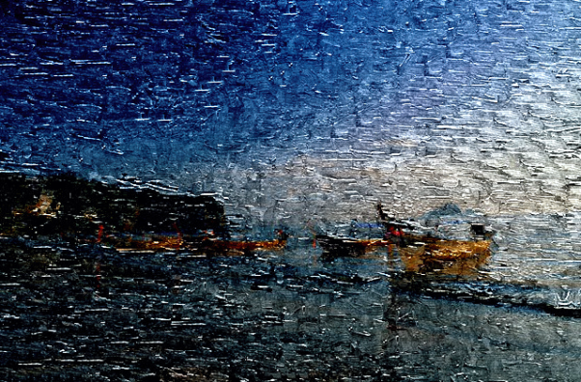
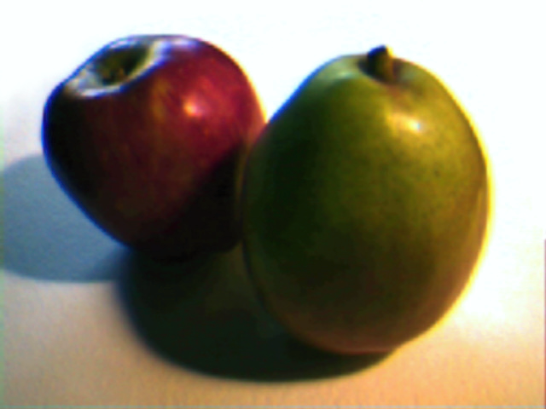
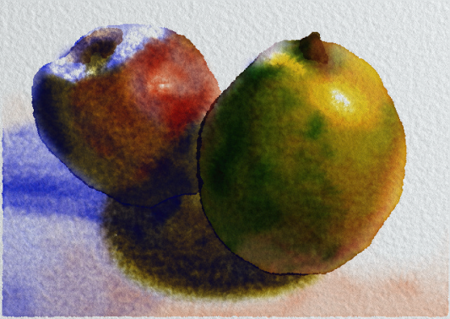
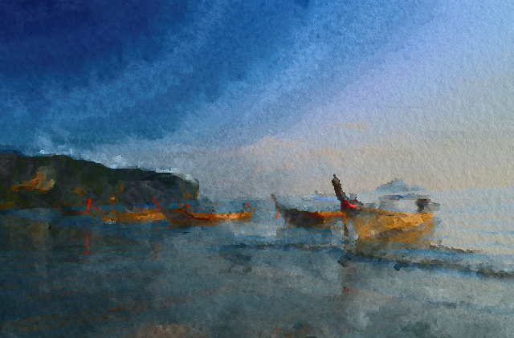
Image Analogies Hertzmann et al. (2001)
Style Transfer Examples
Learn
Apply
Learn
Apply
Other extensions to video [Hors & Essa ’02] and to take orientation into account [Lee et al. ‘10]

Slide 26
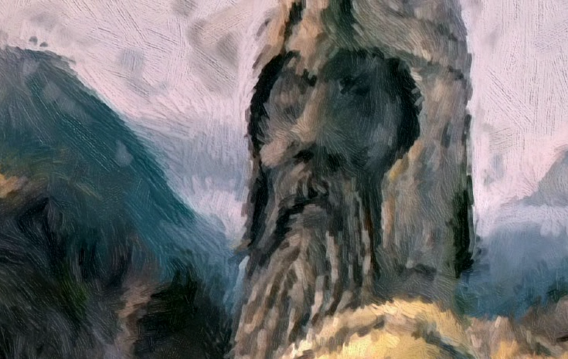
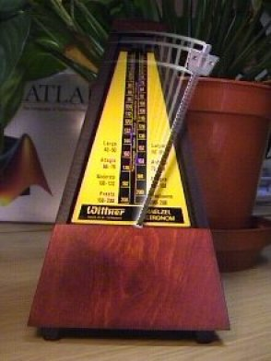
Video Painting
Video Stylisation
Techniques to create painterly animations or cartoons from video
Enabled by automated techniques for image stylization
Stylised Appearance
Stylised Motion

Slide 27
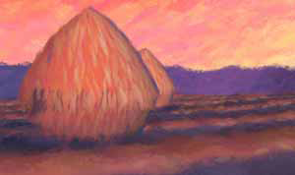
Temporal Coherence
Goal of video stylization
Create the desired aesthetic exhibiting good temporal coherence
Temporal coherence is here defined as:
1. Absence of distracting flicker
2. Motion of brush strokes (or other component marks) is in agreement with the motion of content
Naïve approaches
Repaint every frame independently
= Flicker (violates 1.)
Fix strokes in place and change attributes e.g. colour according to video content
= Motion unmatched (violates 2.)
“the shower door effect” – Barb Meier
Meier ‘96

Slide 28
Processing Images & Video for Impressionist Effect Litwinowicz (1997)
Painterly animation using Optical Flow
Brush strokes are pushed from frame to frame using flow estimate
Oscar winning visual effects in movie “What Dreams May Come” (1998)
Manual correction of flow estimate (~1000 person-hours [Green’99])
(c) Universal 1998

Slide 29
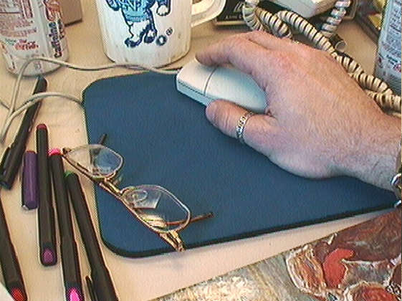
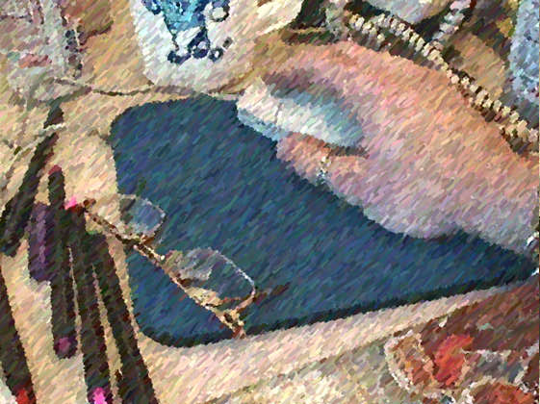
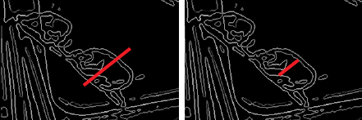
Processing Images & Video for Impressionist Effect Litwinowicz (1997)
Sobel edge
direction
No clipping
Clipping
Image edge
seed
Stroke grows from seed point bidirectionally until edge pixels encountered
Photo credit: Litwinowicz ‘97

Slide 30
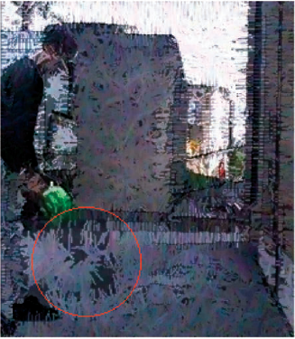
Processing Images & Video for Impressionist Effect Litwinowicz (1997)
Initialisation as per single image (regular seeding)
Randomise rendering order of strokes
Strokes translated to next frame via flow field
Greedy approximation to avoid irregular coverage
Delaunay triangulation of seeds (and image corners)
Death. Seeds too close together are deleted
Tested in random order
Birth. Triangles with area > threshold are subdivided
New seeds are randomly inserted in rendering order
Photo credit: Litwinowicz ‘97

Slide 31
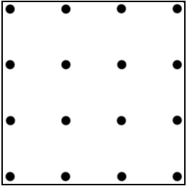
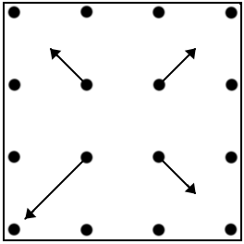
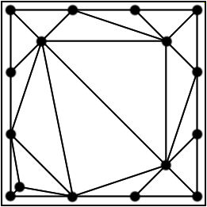
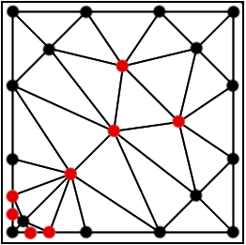
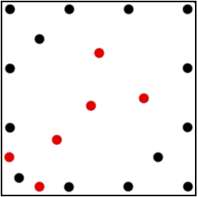
Processing Images & Video for Impressionist Effect Litwinowicz (1997)
Stroke Birth
Photo credit: Litwinowicz ‘97

Slide 32
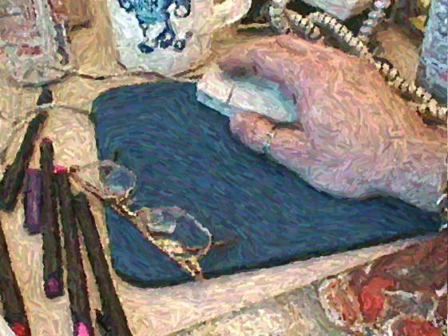
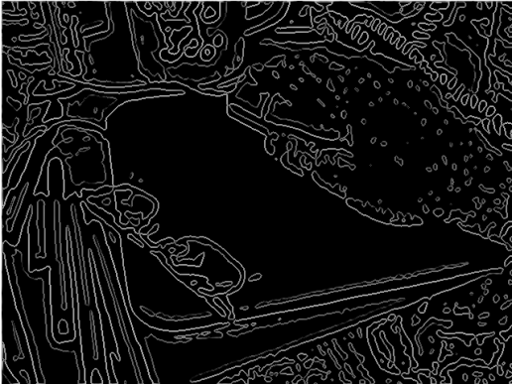
Processing Images & Video for Impressionist Effect Litwinowicz (1997)
Tips on reducing flicker
Detect your own scene cuts and reinitialise
Use a robust Optical Flow algorithm (!)
e.g. SIFTFlow or Brox
Pre-filter heavily (Gaussian). Care with interlaced content.
Interpolate orientations from strong edges only
Smooths out codec noise
Litwinowicz uses thin-plate spline (expensive) but can use Poisson filling (fast on GPU) to good effect
Without interpolation
Sobel edge
direction
Image edge
seed
With interpolation
Sobel field
Photo credit: Litwinowicz ‘97

Slide 33
Processing Images & Video for Impressionist Effect Litwinowicz (1997)
Main sources of temporal incoherence
Motion matching
Optical Flow = visual correspondence problem
Inevitable inaccuracies in estimate are cumulative
Content appears to slip below strokes = shower door effect
Manual correction of OF mitigates this but is expensive
Flicker
Random order of new strokes disguises regularity
…but the noise generates flicker
Sudden disappearance of strokes exposes others = popping
Sobel edges are noisy at moderate scales
Strokes are clipped against flicking edge map

Slide 34
Improving the Coherence of Flow-based Schemes
Main sources of temporal incoherence
Addressed by
Motion matching
Optical Flow = visual correspondence problem
Inevitable inaccuracies in estimate are cumulative
Content appears to slip below strokes = shower door effect
Manual correction of OF mitigates this but is expensive
Hertzmann and Perlin
NPAR 2000
Flicker
Random order of new strokes disguises regularity
…but the noise generates flicker
Sudden disappearance of strokes exposes others = popping
Sobel edges are noisy at moderate scales
Strokes are clipped against flicking edge map
Hays and Essa
NPAR 2004

Slide 35
Painterly Rendering for Video and Interaction Hertzmann and Perlin (2000)
Repaint only the areas that change significantly
Fast – enables realtime interaction
Limits shower-door by repainting limited regions of canvas (“paint-over”)
RGB Difference to detect regions
Optical flow optionally used to translate strokes
Control points shifted under flow

Slide 36
Paint-Over
Hertzmann ‘00

Slide 37
Paint-Over and Optical Flow
Hertzmann ‘00

Slide 38
Image and Video-based Painterly Animation Hayes & Essa (2004)
Key Innovation
Temporal smoothing of stroke attributes
Stroke Opacity for birth/death
Orientation
RBF interpolated field (similar to Litwinowicz)
But interpolated from strokes marked “strong” not from per-frame orientation field
Strokes born on strong edges
Length and orientation are also smoothed
width
length1
opacity
colour
length2
θ
seed
point

Slide 39
Image and Video-based Painterly Animation Hayes & Essa (2004)

Slide 40
Image and Video-based Painterly Animation Hayes & Essa (2004)

Slide 41
Video Watercolorization by bi-directional advection Boisseau et al. (2007)
Bi-Directional Flow (of textures vs. strokes)
Adaptation of “Texture advection” from flow visualisation
Frequent occlusions in video motivated bi-directional flow
Two textures seeded – one flows forward, one back
Advect
Advect
Trend towards more global temporal analysis

Slide 42
Video Cubism Klein et al. (2002)
Temporally local (inter-frame) approaches
No long-view of video structure
necessitates averaging of past information
Averaging mitigates flicker but exaggerates the shower door effect
Spatio-temporal primitives
Interactively painted
Temporally contiguous strokes
timeslice
time

Slide 43
Space-time Segmentation for Video Stylisation
Automated Space-time Analysis
Goal is coherent segmentation of video into semantic regions
Coherent space-time regions are smoothed then do not flicker
Extending Mean-shift to Space-time (3D)
Mean-shift segment frames and associate (2D+t)

Slide 44
Stroke Surfaces: Coherent Artistic Animations from Video Collomosse et al. (2005)
Region association (2D+t)
Based on a weighted blend of heuristics
Shape (Fourier Descriptors)
Colour
Overlap (as DeCarlo/Santella)
Associations are filtered by locating
Short-time branches
Short-time cycles
Surface voxels between volumes are identified
Surfaces fragmented into “stroke surfaces” that abut only two volumes

Slide 45
Stroke Surfaces: Coherent Artistic Animations from Video Collomosse et al. (2005)
“Stroke Surfaces” separate volumes
Winged edge structure
Smoothing the surface smoothes the volumes
Generalisation of snakes to 2D surfaces
Separate terms for spatial and temporal constraint

Slide 46
Stroke Surfaces: Coherent Artistic Animations from Video Collomosse et al. (2005)
Surface Manipulation
Undulation
Fragmentation

Slide 47
Stroke Surfaces: Coherent Artistic Animations from Video Collomosse et al. (2005)

Slide 48
Stroke Surfaces: Coherent Artistic Animations from Video Collomosse et al. (2005)
Coherent Segmentation

Slide 49
Rotoscoping for Painterly Rendering Agarwala et al. (2004)
Rotoscoping
Coherent motion of (groups of) regions can be exploited to paint coherently
Interpolate internal points (e.g. stroke seeds) from region boundary
Shape Contexts used to correspond regions
Linear interpolation from corresponded control points on external boundary

Slide 50
Video Tooning Wang et al. (2004)
Rotoscoping

Slide 51
Video Tooning Wang et al. (2004)
Rotoscoping
Coherent motion of (groups of) regions can be exploited to paint coherently

Slide 52
Cartoon Style Rendering of Motion Collomosse et al. (2003)
Motion Emphasis
Augmentation cue (Speed-lines, ghosting)
Deformation (Squash and stretch, general deformation)
Time warping (Anticipation/snap)

Slide 53
Augmentation Cues
Augmentation Cues
Segment trails of corresponded control points into smooth sections.
Iteratively select smooth sections to maximising:
user weights
selected sections
mean velocity over x
mean curvature at x
temporal extent of x
dist from convex hull at x
overlap of x and

Slide 54
Squash and Stretch
Deformation Cues
A motion dependent curvilinear basis (s,r) is formed using the trajectory of the region centroid, and its normal.
U(.) as the transformation from curvilinear space, keep the inverse as a lookup table.
Squash and stretch
(after Chenney et al ‘02)

Slide 55
Squash and Stretch
Deformation Cues
Squash and stretch in a camera motion compensated frame

Slide 56
General Deformation
Deformation Cues
More general motion deformations can be created by specifying a transfer function dependent on a point’s local acceleration and position, as well as its speed.
A function can operate on each component of independently, to create effects suggesting drag we use...

Slide 57
Video Analysis for Dynamic Cues Collomosse and Hall (2005)
Anticipation (Snap)
Alter motion timing to introduce a lag then “catch up” prior to changes of motion

Slide 58
Video Paintbox: The Fine Art of Video Painting Collomosse and Hall (2006)
A Complete Video Paintbox
Segmentation + augmentation + deformation
Anticipation + deformation

Slide 59
Motion Magnification Liu et al. (2005)
Deformation Cues
General deformation technique using motion vector clustering to layer video
User intervention needed to fix noisy segmentation maps
Per-pixel flow vector pushes pixels to exaggerate existing motion
Texture filling compensates for holes
Liu et al. ‘05

Slide 60
Multi-label Propagation for Video Stylisation Wang et al. (2010)
Combining Segmentation and Optical Flow
Multi-label graph-cut segmentation with label prior propagated forward from previous frames
Region colour models are learned incrementally
propagation to next...
Wang et al. ‘10

Slide 61
Multi-label Propagation for Video Stylisation Wang et al. (2010)
Combining Segmentation and Optical Flow
For each pixel within frame
Find best mapping
Subset of are carried from t-1 by SIFT flow
Colour models are learned over time incrementally via Gaussian Mixtures
Learned colour model
Contrast adaptive
Wang et al. ‘10

Slide 62
Multi-label Propagation for Video Stylisation Wang et al. (2010)
Region colour distribution (GMM) updated with temporal weight
Comparison with historic model (Chi^2) detects region birth
Graph-cut
EDISON
Paris( ECCV08)
Region born
Wang et al. ‘10

Slide 63
The trend back to semi-automated systems
Trends from automatic ‘Tooning to interactive tools
The necessity of interaction to solve the general segmentation problem
Video Snap-Cut
Complex Interactive Painting Systems
Manual Seg.
Manual Seg.
Seg.
Track strokes
Bai et al. ‘09
Liang et al. ‘10
Yet many applications demand automation or real-time. Part III discusses solutions.

Slide 64
Artistic Stylisation of Images and Video
Coffee Q & A
After the break!
Part III - Anisotropy and Diffusion
Part IV - Future Challenges in NPR
Photo credits as noted in Part III

